Slide 1

IBM Business Intelligence Analyst Capstone Project
By Stephen Caponigro

Slide 2

Table of Contents
Introduction
Methodology
Results
Discussion
Conclusion
Appendix
Stock ID: 47857043

Slide 3

Introduction

Slide 4

Introduction
You have recently been appointed as a BI Analyst by a leading retail chain that operates globally, renowned for its diverse product offerings and commitment to customer satisfaction.
To maintain its competitive edge and optimize business performance, the company is leveraging data-driven insights to enhance sales strategies and operational efficiency.

Slide 5

Methodology

Slide 6
Methodology
Primary responsibility is to conduct a comprehensive analysis of sales performance of the retail chain across different regions and time periods.
Objective is to identify key factors that influence sales, including daily sales data, store locations, product hierarchies, and promotional strategies.
Valuable insights from looking into sales data extracted from daily sales records, product hierarchy details, and store information.

Slide 7
Data Details
Data Compilation:
Extract data from multiple files to gain insights from daily sales data, store locations, and product hierarchy
Data Cleaning and Analysis:
Conduct thorough cleaning of all collected data to ensure accuracy
Analyze the cleaned data to identify trends and patterns
Data Querying and Further Analysis:
Utilize queries to extract specific information from the dataset
Perform additional analysis to gain deeper insights into sales performance
Chart Creation and Regression Analysis:
Develop visual representations to illustrate the findings effectively
Utilize regression analysis to explore relationships and dependencies within the data
Data Visualization:
Present the analyzed results visually so stakeholders can easily comprehend and interpret the data

Slide 8
Module 1: Data Cleaning and Preparation Using Excel
Initial task involves meticulously cleaning and analyzing sales data using Excel to gain better understanding of trends and patterns.
Sales Data Analysis
Sales by City Analysis
Product Performance Analysis

Slide 9
Module 2: Data Querying and Analysis Using PostgreSQL
Using PostgreSQL, you will create data cubes with ROLLUP, summarize data along hierarchies, and identify trends by combining time and geographical data. This will enable you to extract actionable insights to optimize sales strategies and stock management.

Slide 10
Module 3: Data Visualization and Statistical Analysis
In this phase, you will focus on creating insightful charts using Excel and conducting regression analysis to uncover correlations between sales figures and dates. This analysis will provide valuable insights into sales trends and seasonal patterns, facilitating informed decision-making.

Slide 11
Module 4: Data Visualization and Dashboards Using Tableau
Harnessing the power of Tableau, you will create dynamic dashboards and visualizations to present key findings related to sales performance, regional sales analysis, product analysis, and store performance. Your visualization efforts will facilitate clear communication of insights and support strategic decision-making processes.

Slide 12
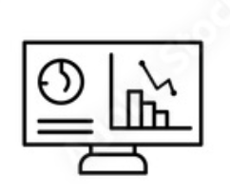
Results

Slide 13
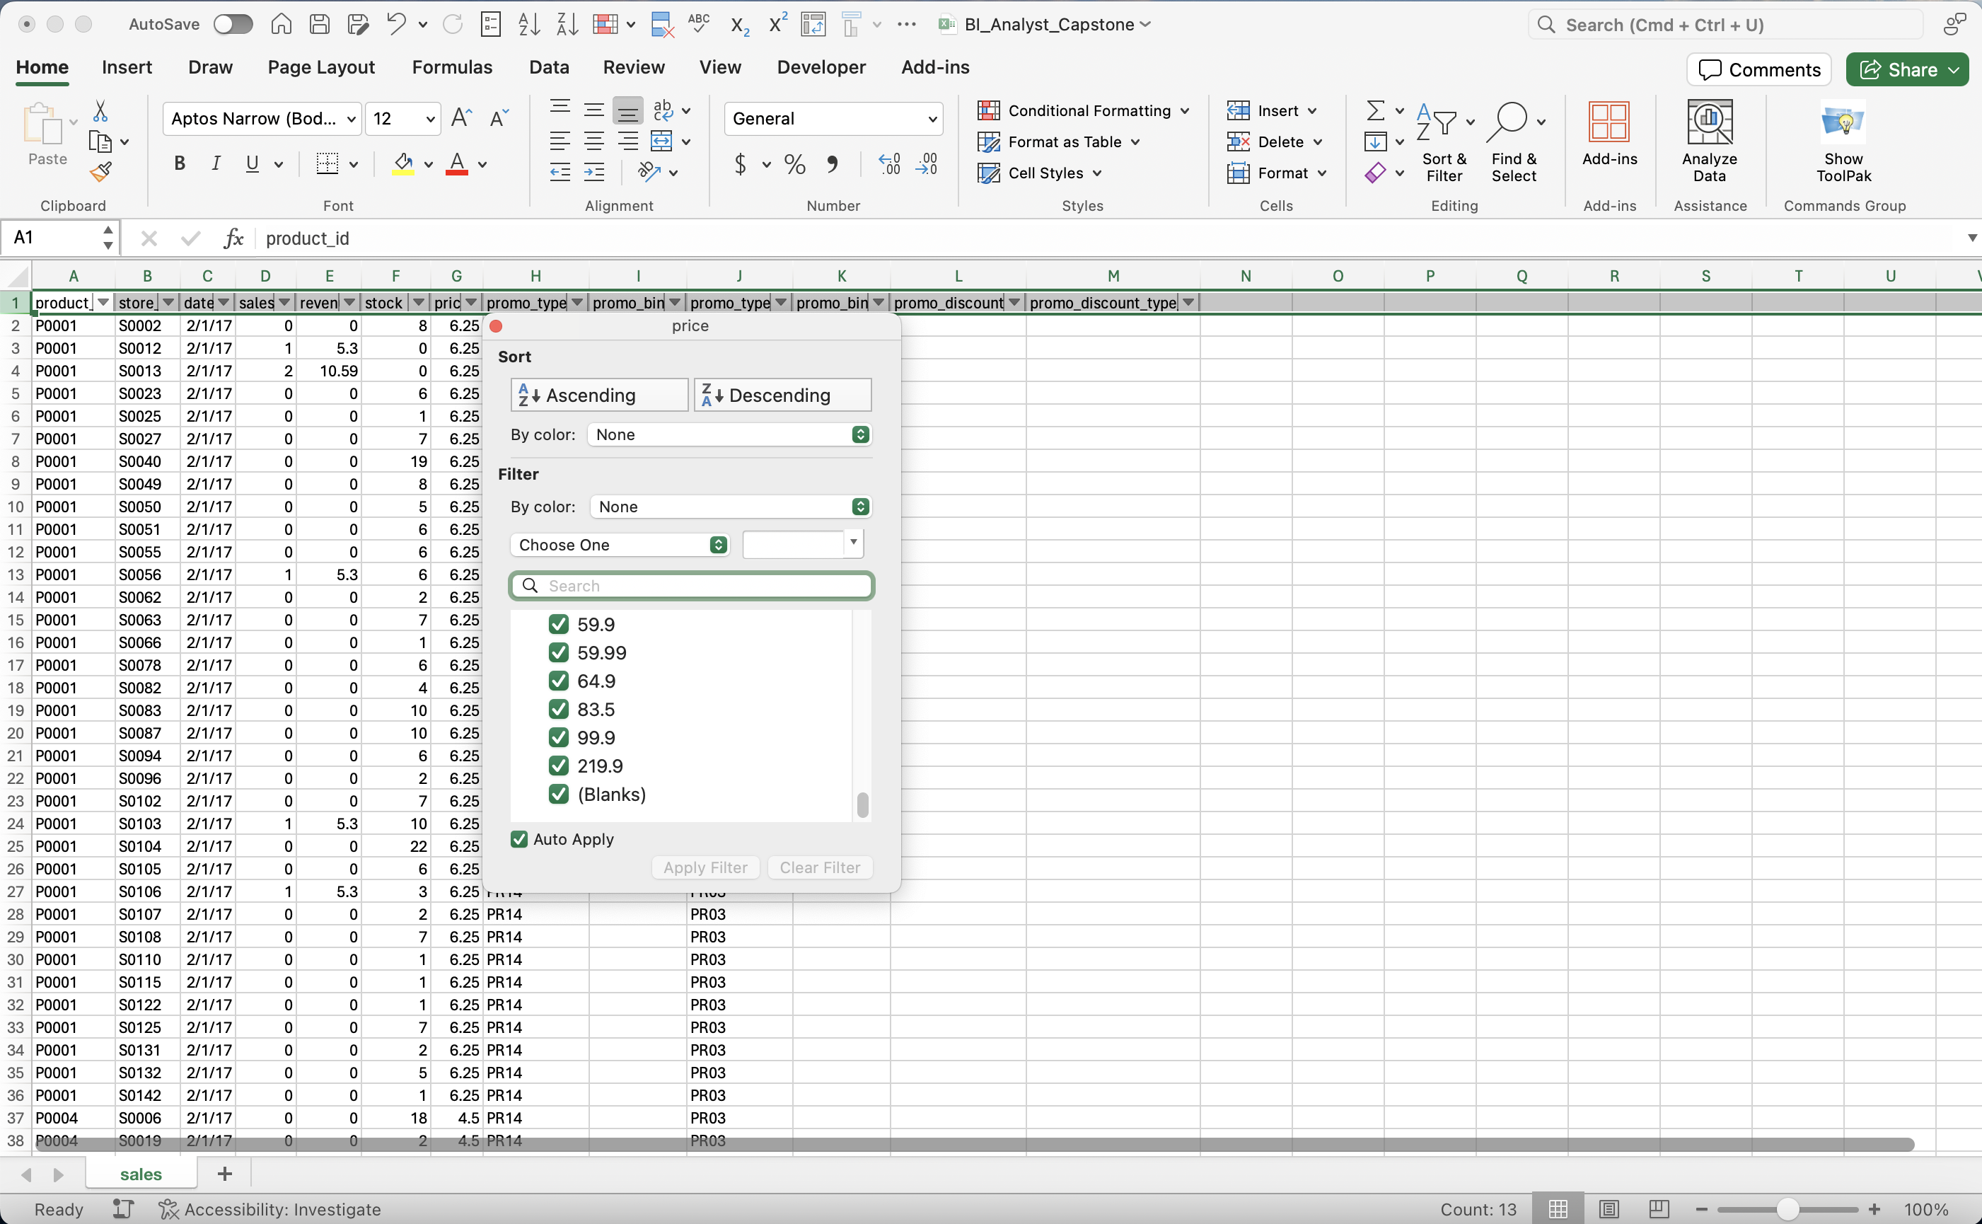
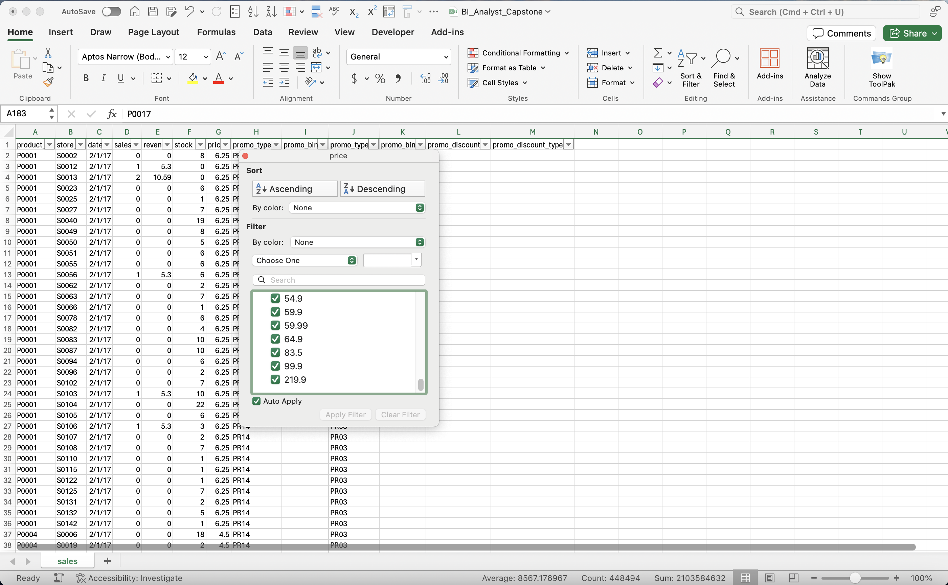
Module 1, Lesson 1: Data Cleaning and Preparation
Remove Blank Values: price

Slide 14
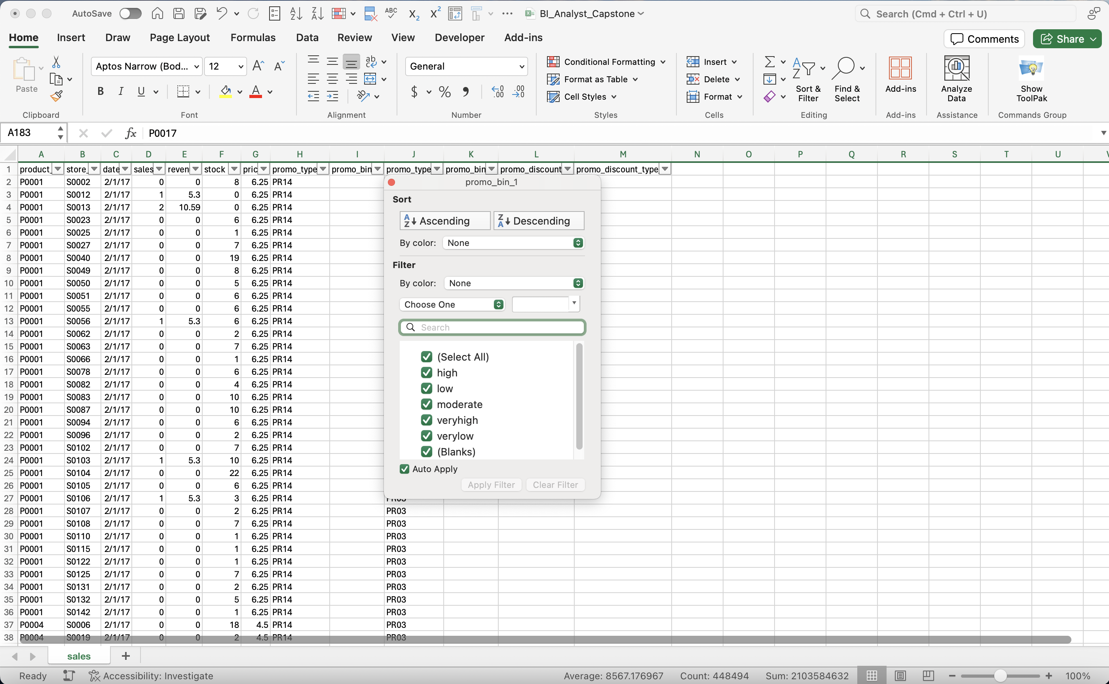
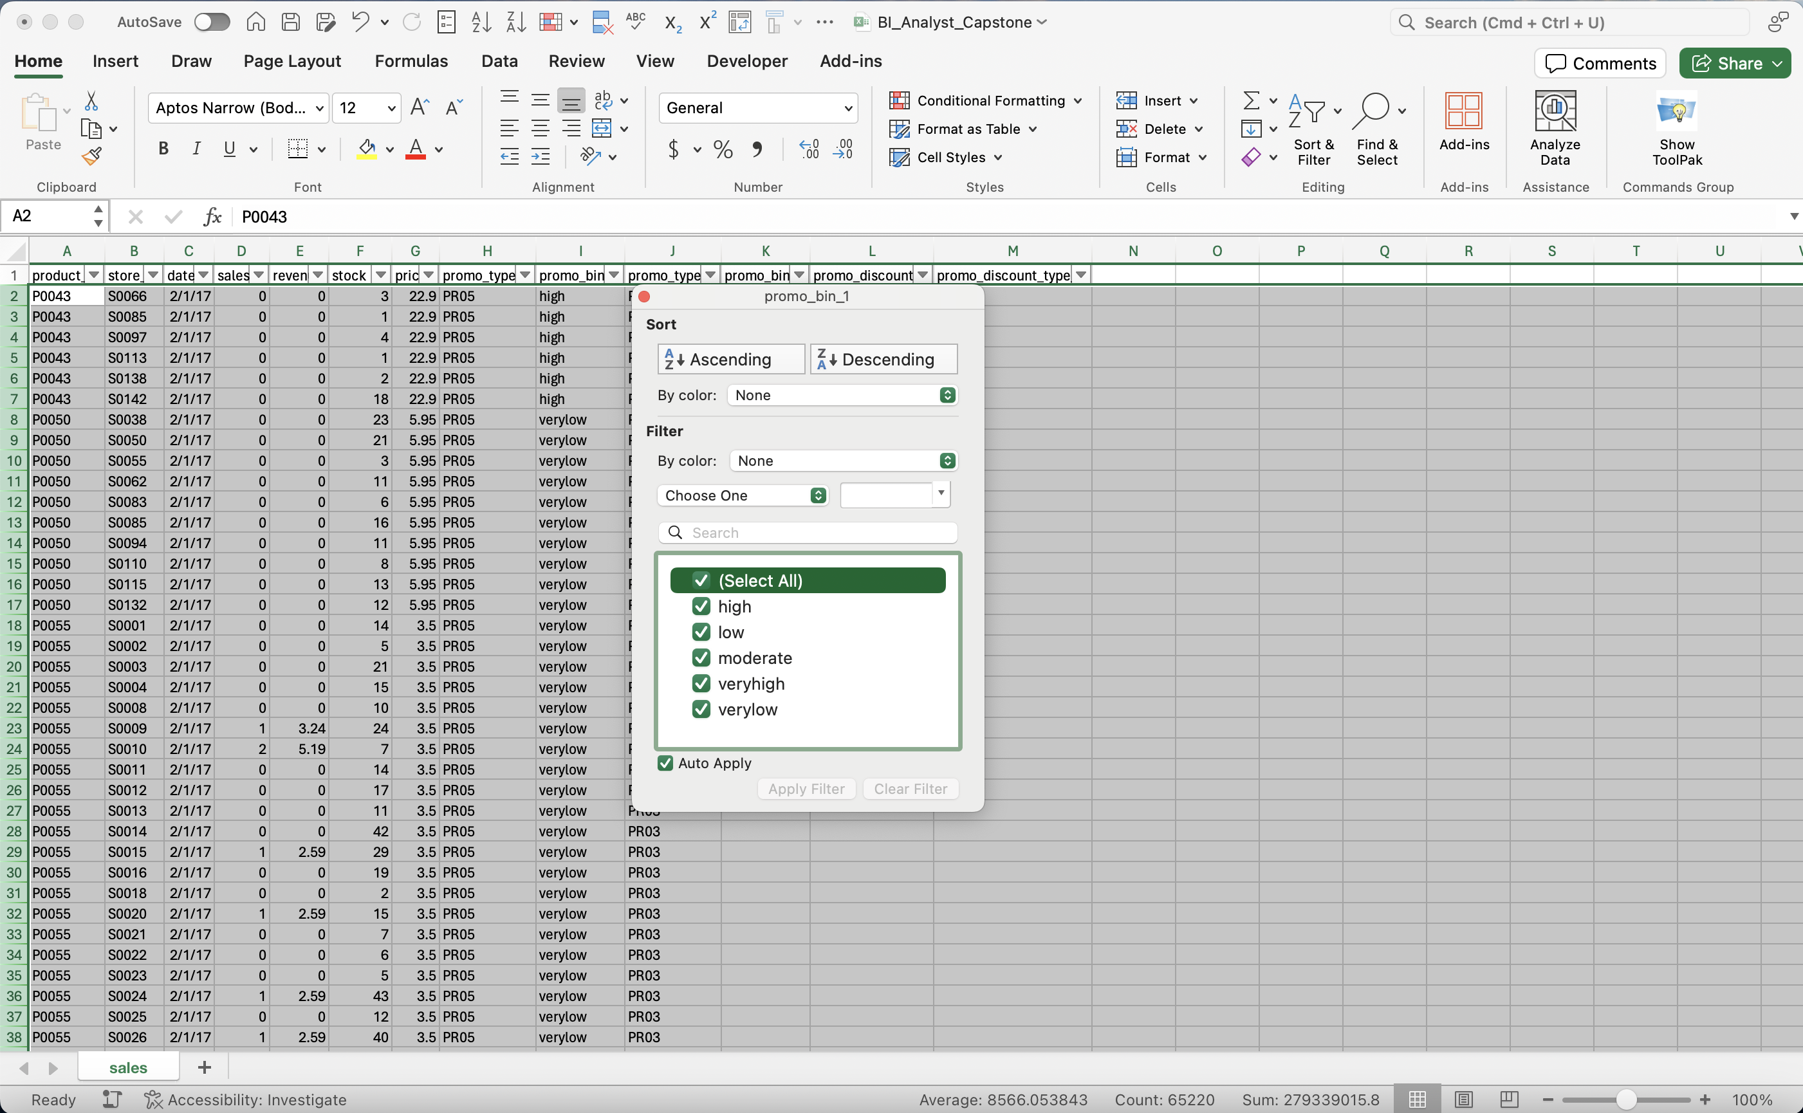
Module 1, Lesson 1: Data Cleaning and Preparation
Remove Blank Values: product_bin_1

Slide 15
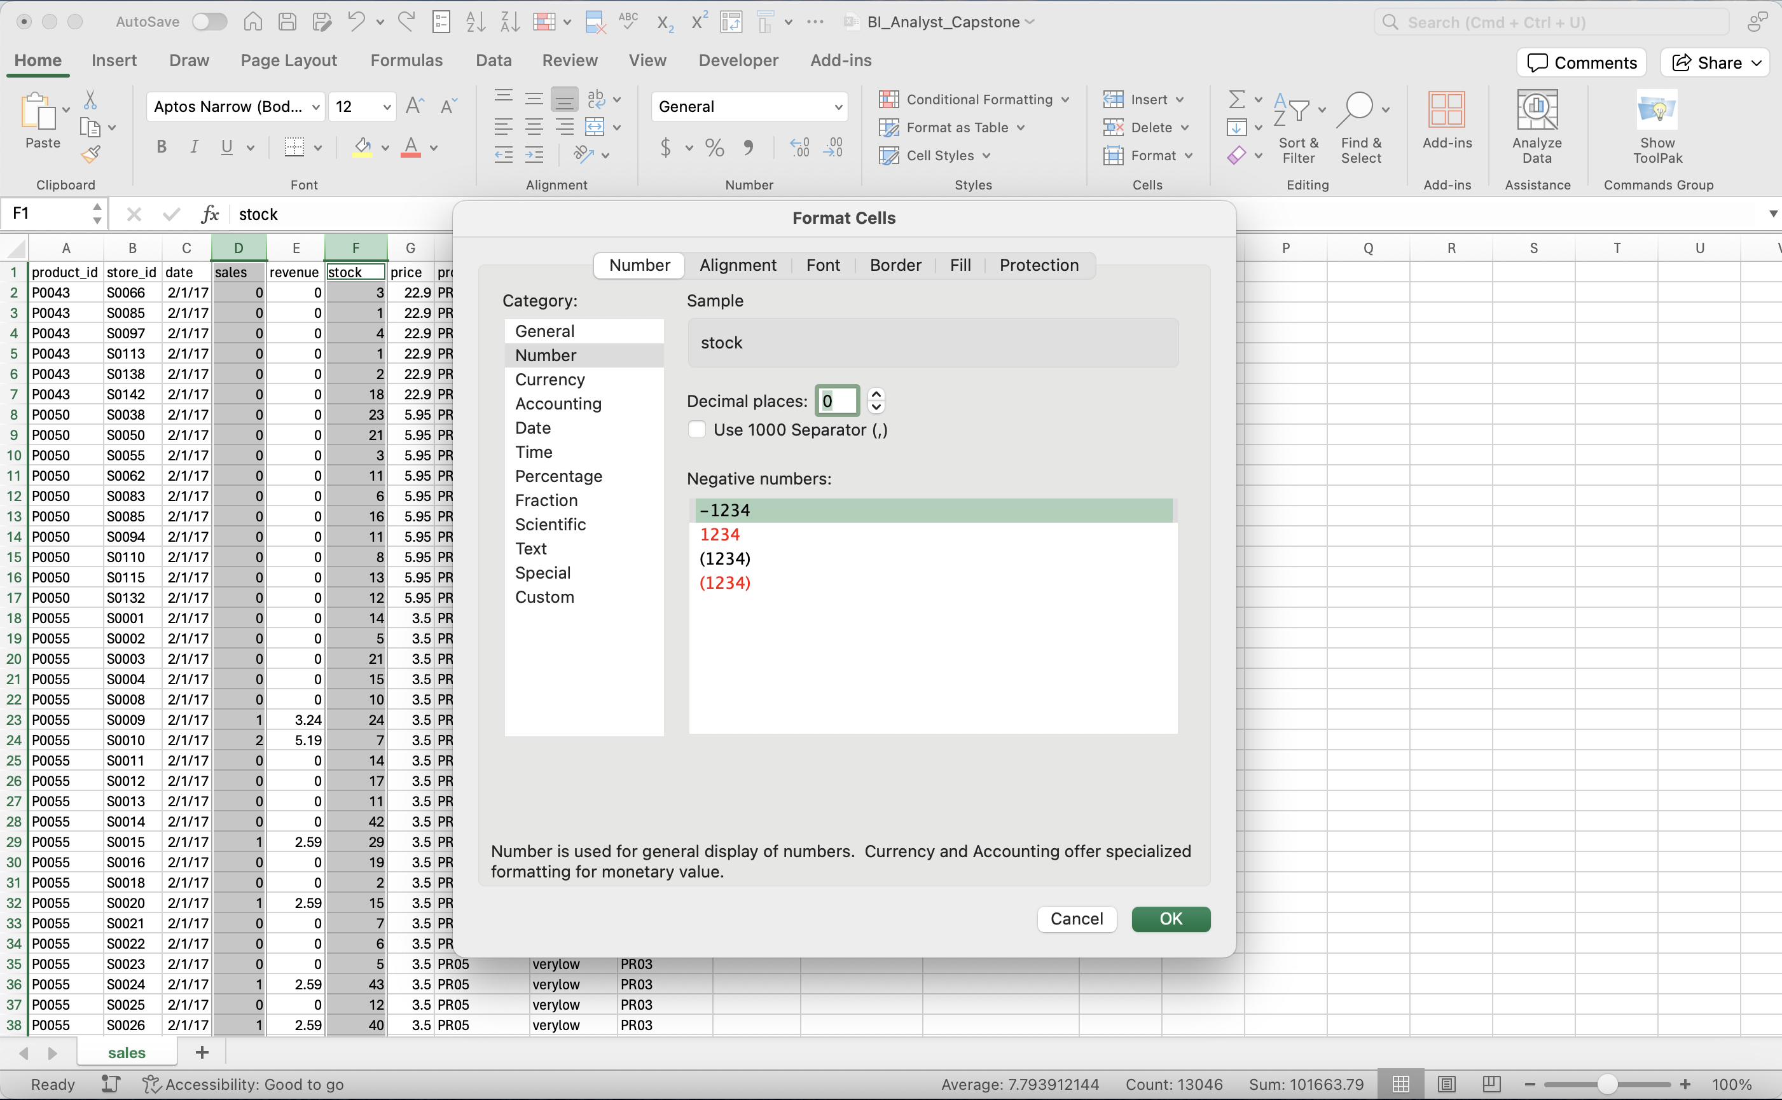
Module 1, Lesson 1: Data Cleaning and Preparation
Format Number

Slide 16
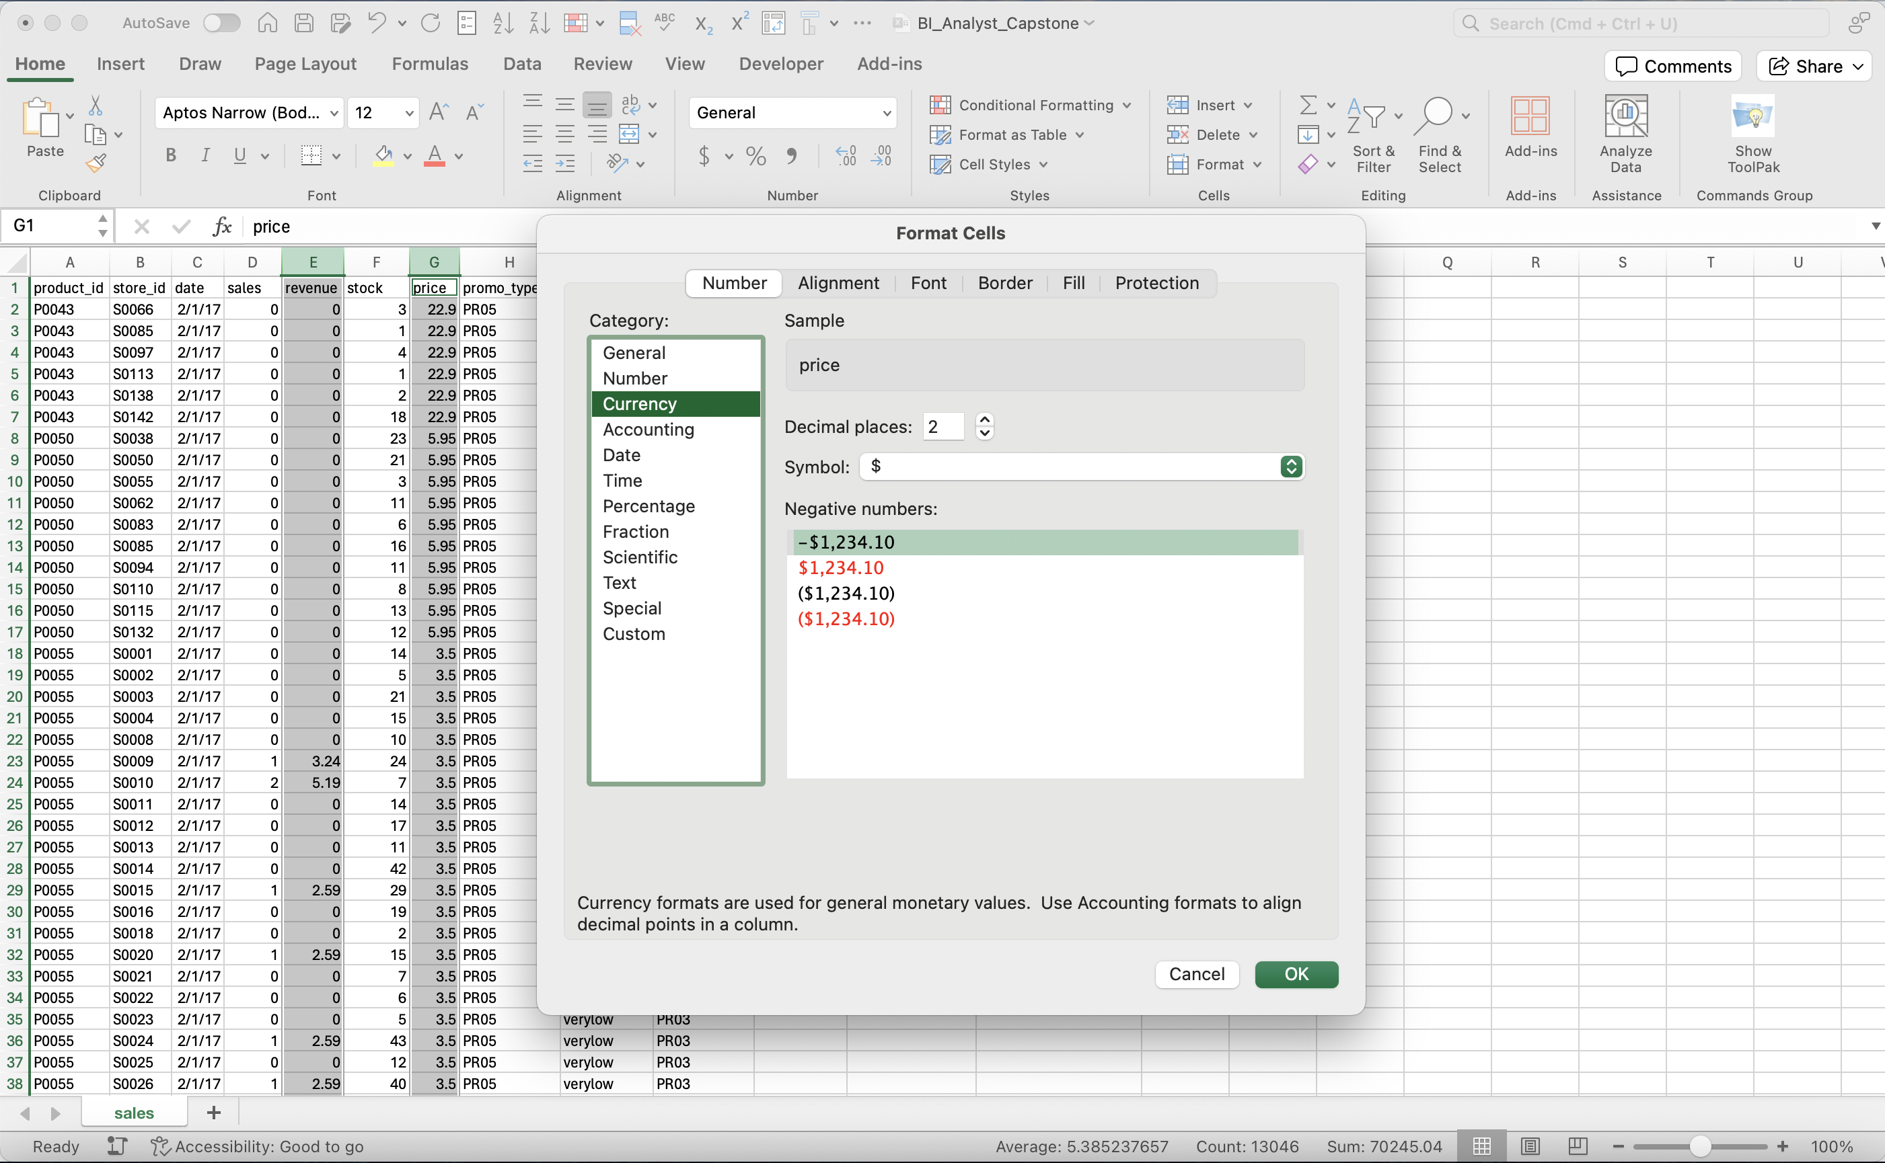
Module 1, Lesson 1: Data Cleaning and Preparation
Format Currency

Slide 17
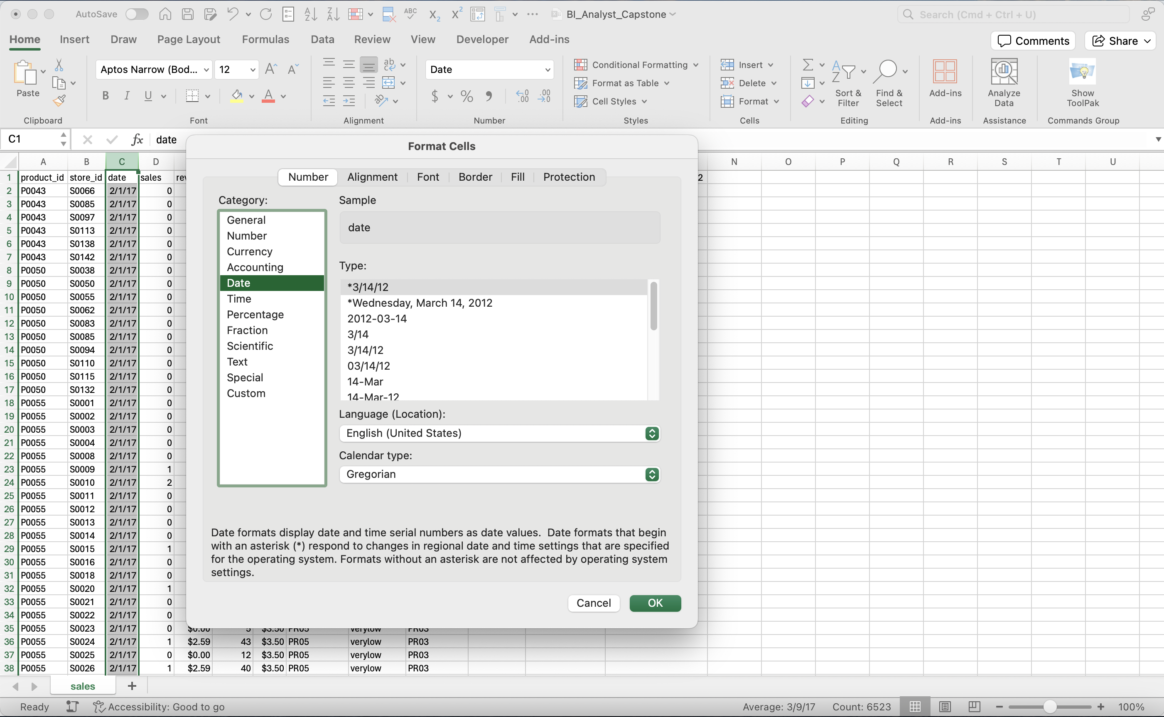
Module 1, Lesson 1: Data Cleaning and Preparation
Format Date

Slide 18
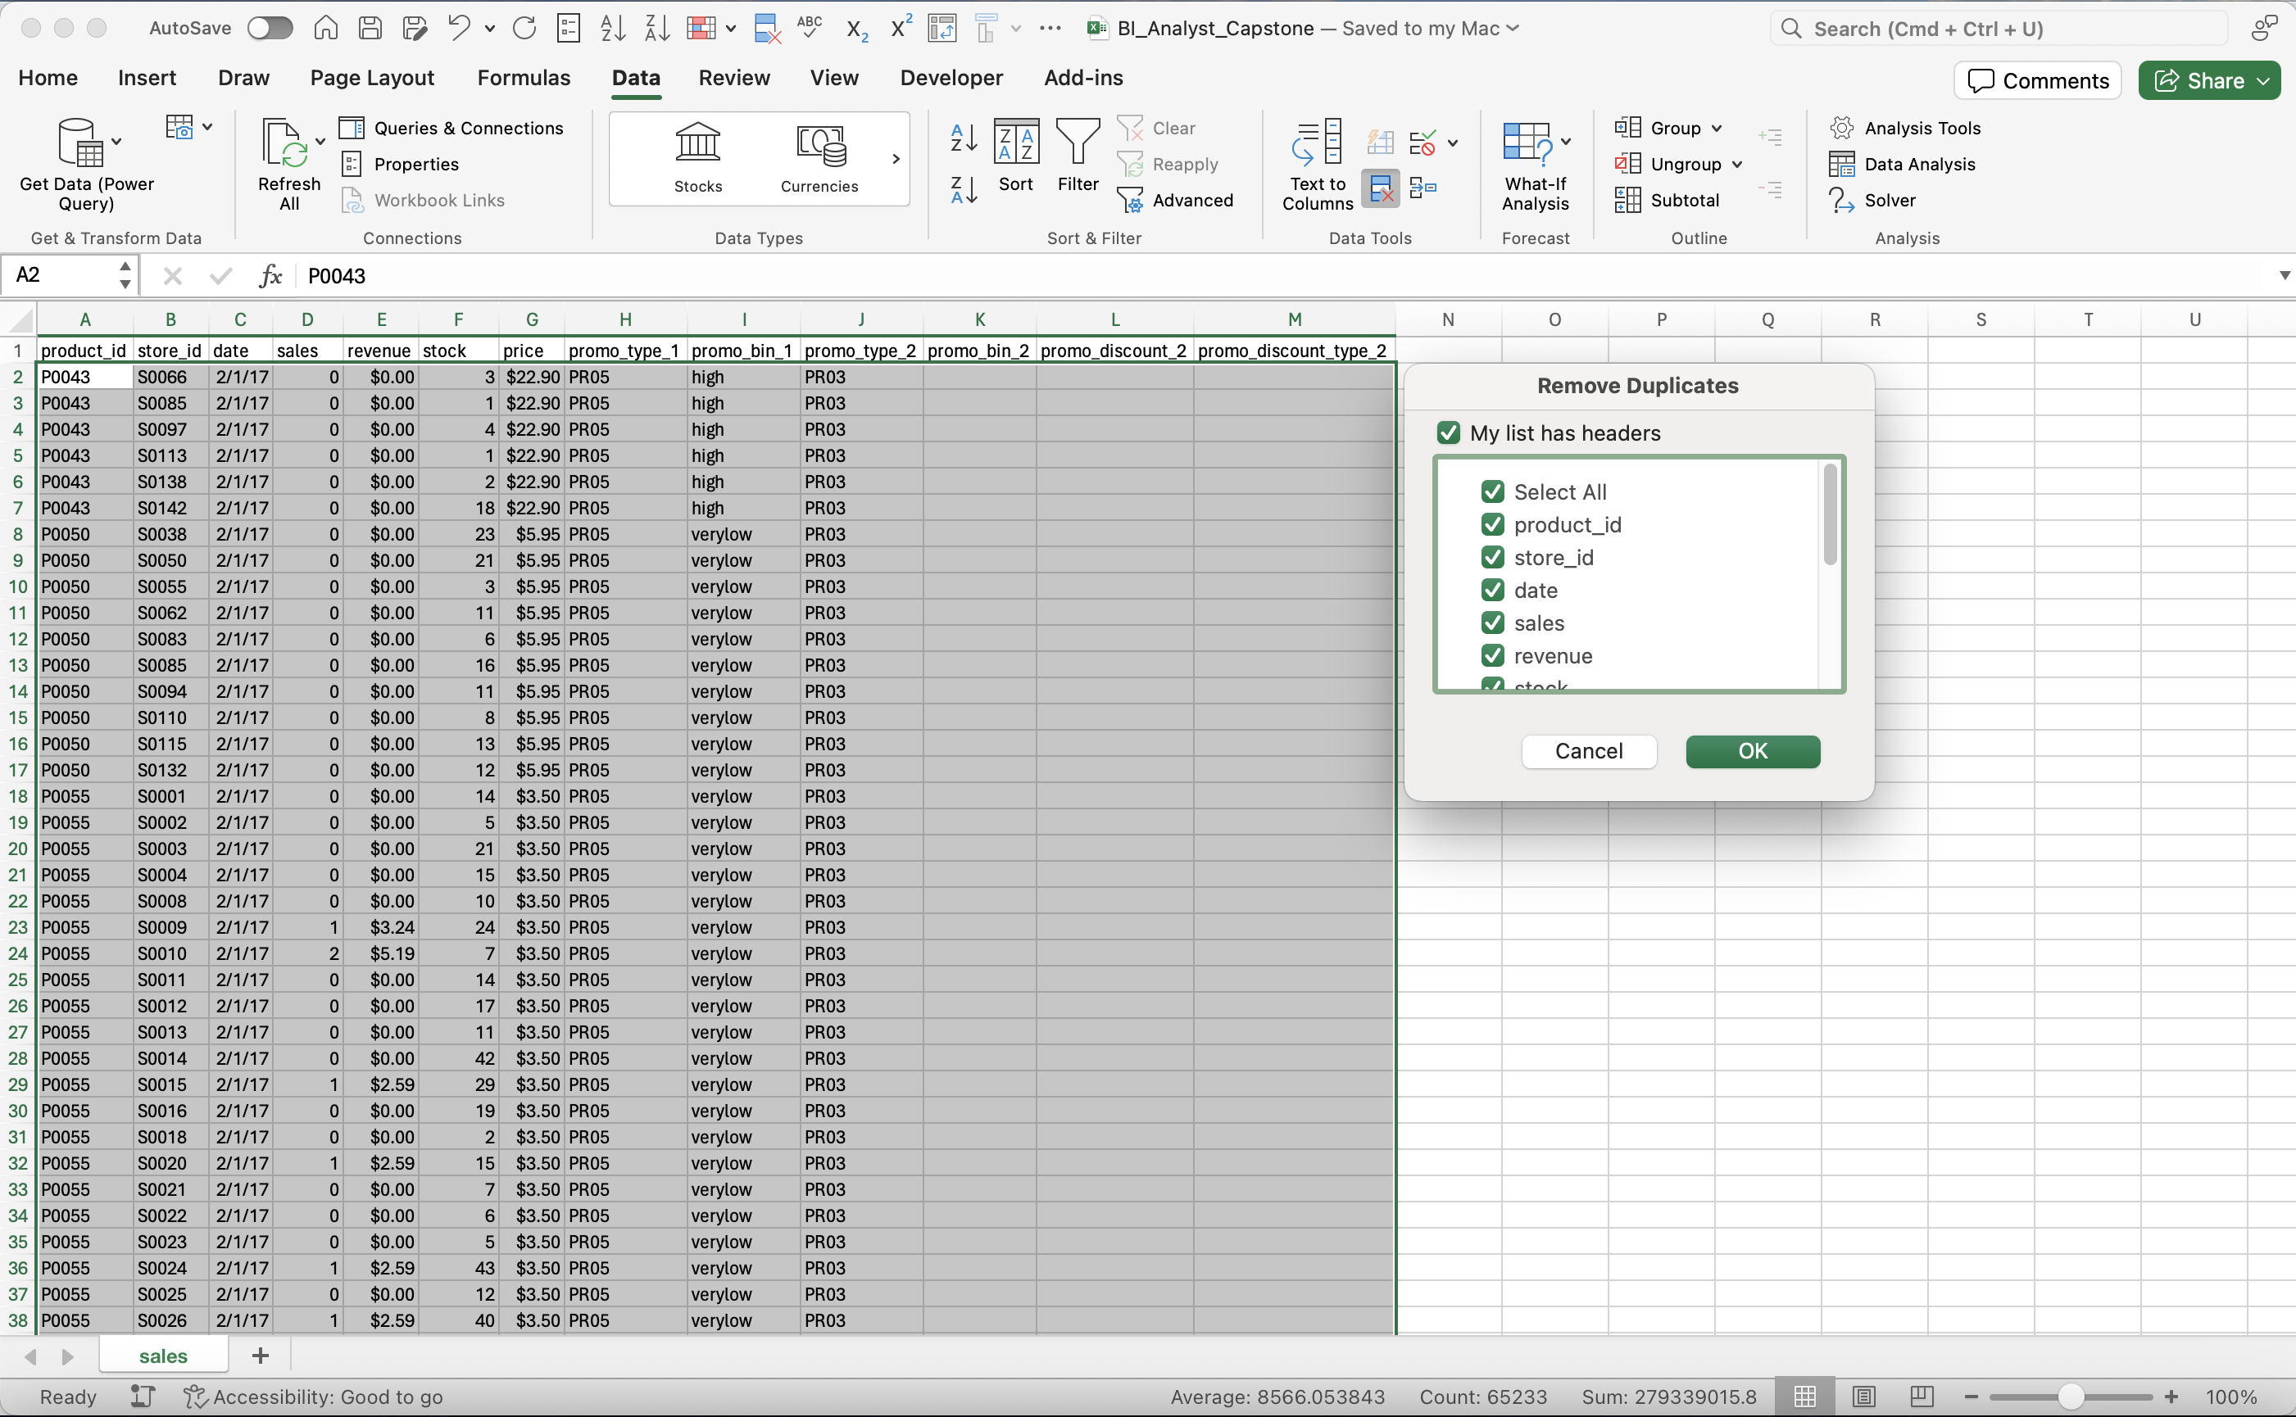
Module 1, Lesson 1: Data Cleaning and Preparation
Remove Duplicates

Slide 19
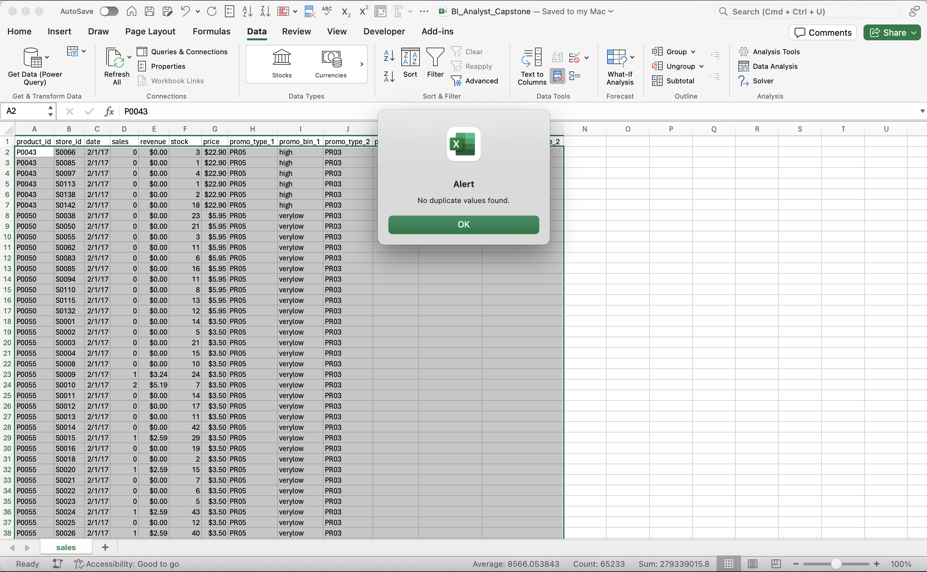
Module 1, Lesson 1: Data Cleaning and Preparation
No Duplicates

Slide 20
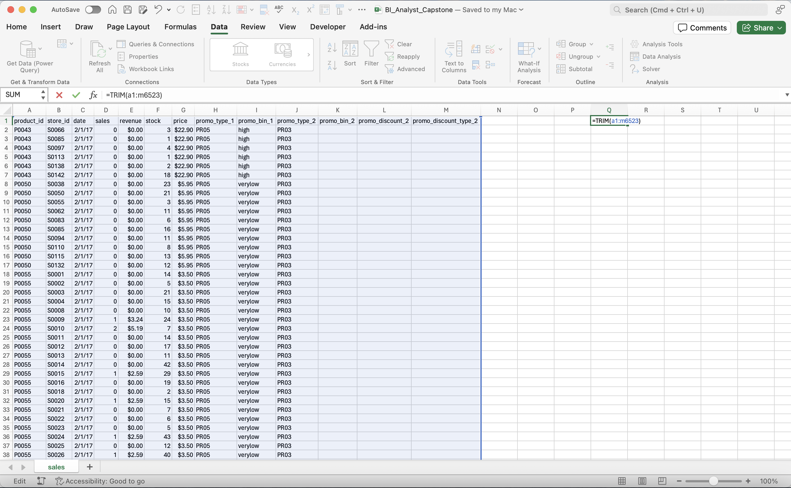
Module 1, Lesson 1: Data Cleaning and Preparation
Remove Extra Spaces with Trim Function

Slide 21
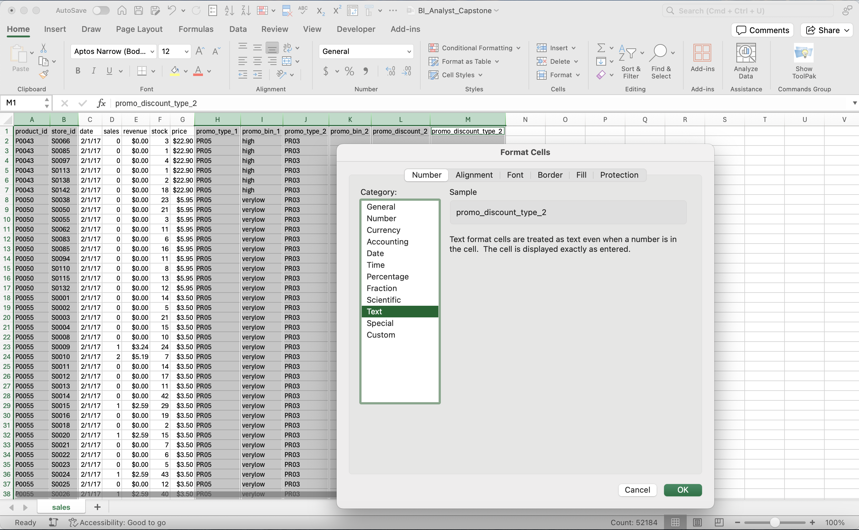
Module 1, Lesson 1: Data Cleaning and Preparation
Format Text

Slide 22
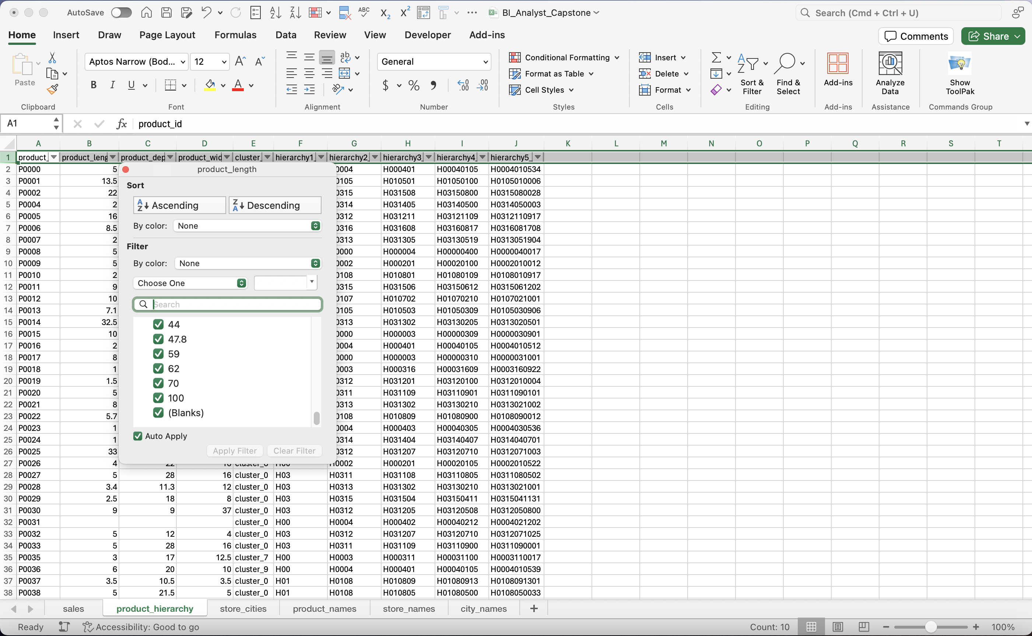
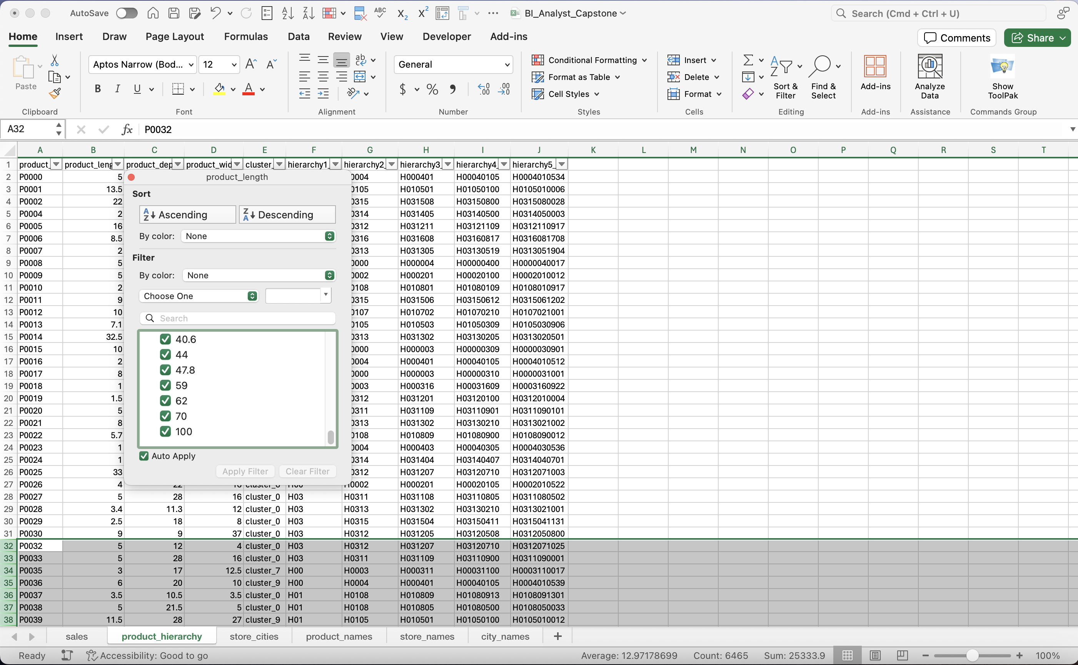
Module 1, Lesson 1: Data Cleaning and Preparation
Remove Blank Values: product_length

Slide 23
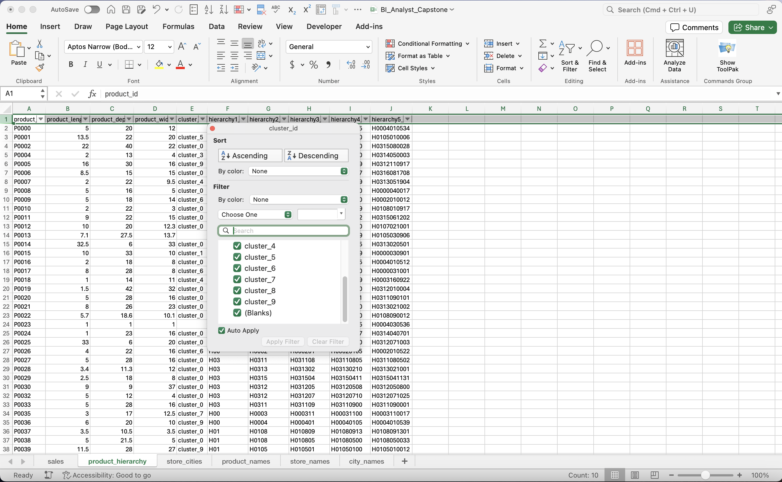
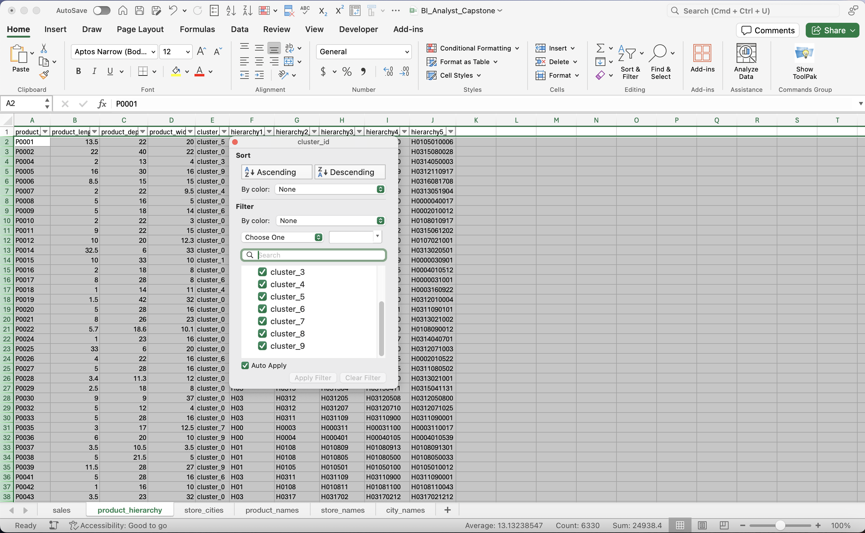
Module 1, Lesson 1: Data Cleaning and Preparation
Remove Blank Values: cluster_id

Slide 24
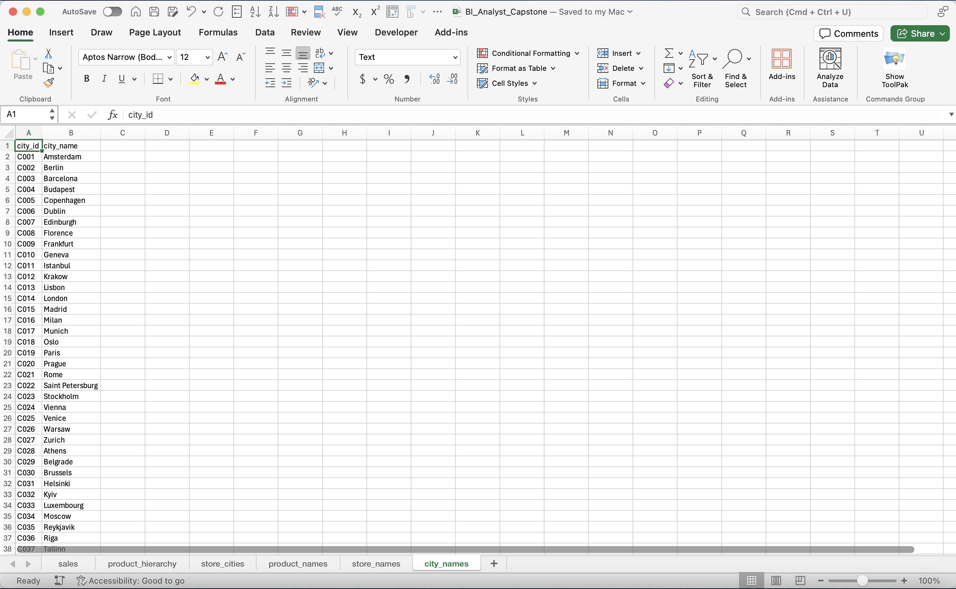
Module 1, Lesson 1: Data Cleaning and Preparation
Final Screenshot

Slide 25
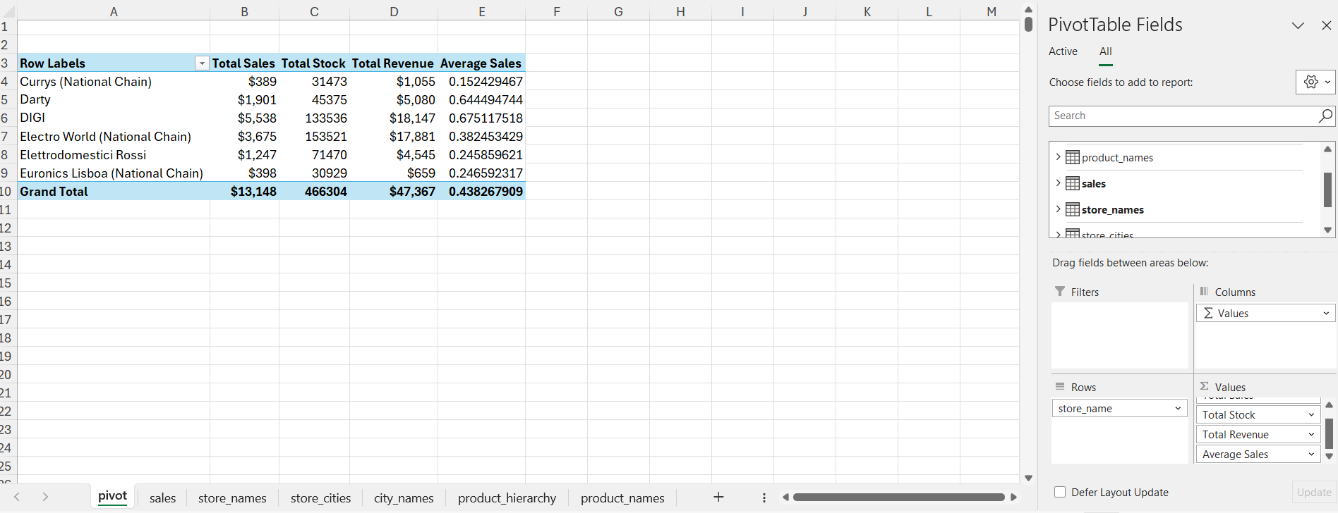
Module 1, Lesson 2: Data Analysis Using Pivot Tables
Sales Data Analysis

Slide 26
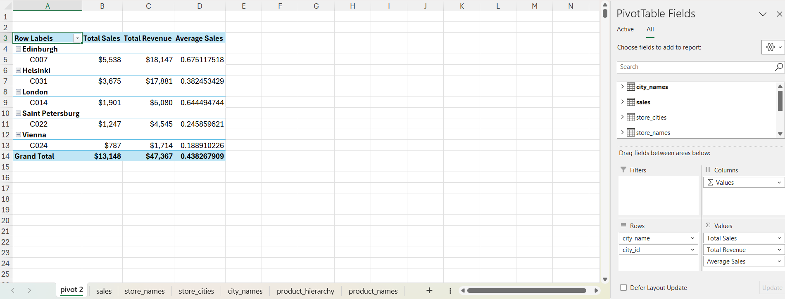
Module 1, Lesson 2: Data Analysis Using Pivot Tables
Sales by City Analysis

Slide 27
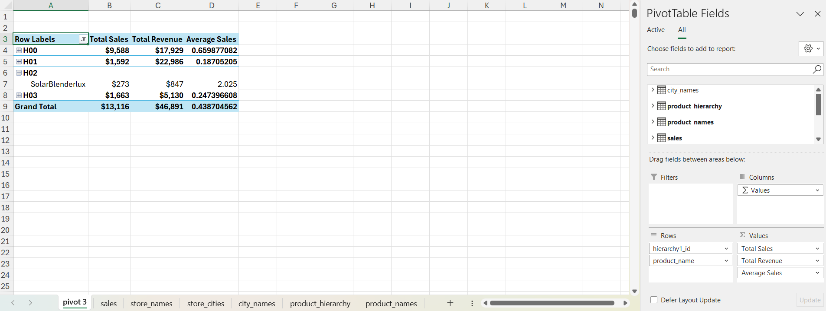
Module 1, Lesson 2: Data Analysis Using Pivot Tables
Product Performance Analysis

Slide 28
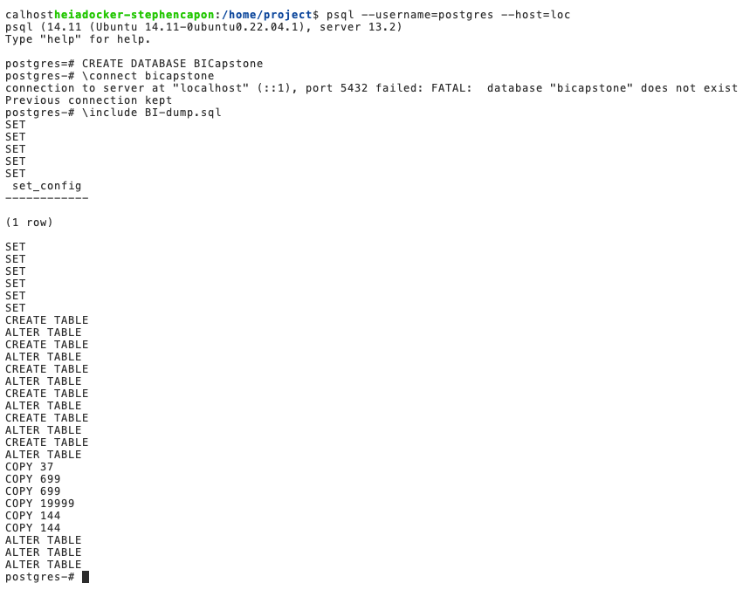
Module 2, Lesson 1: Data Querying Using PostgreSQL
Create Database in PostgreSQL

Slide 29
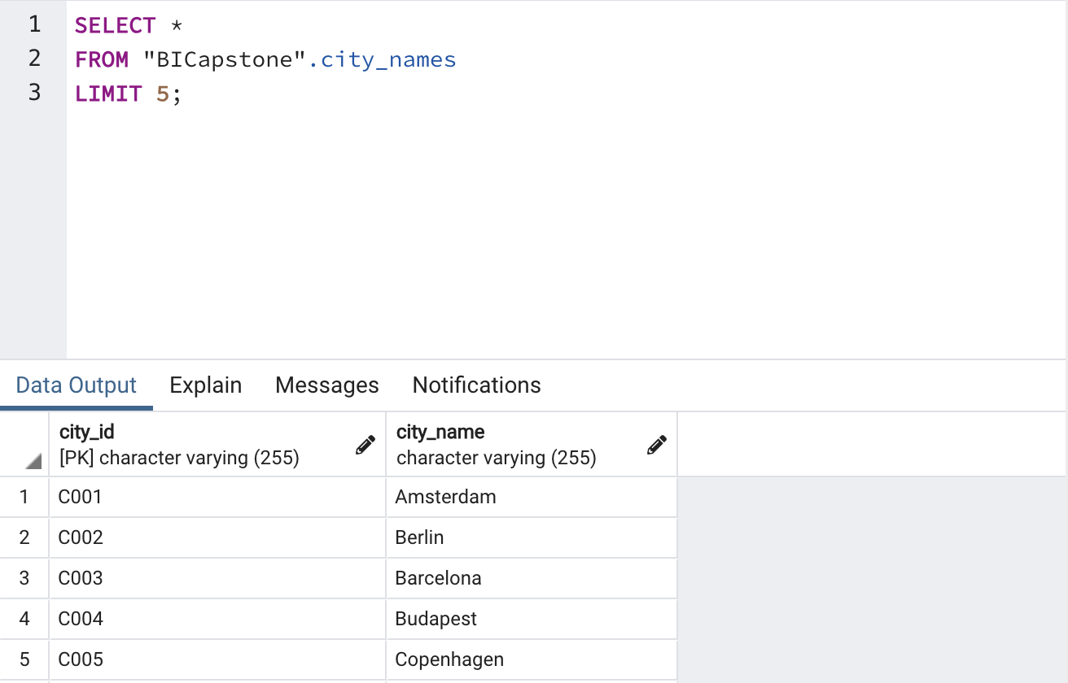
Module 2, Lesson 1: Data Querying Using PostgreSQL
Query that shows data was populated in the database

Slide 30
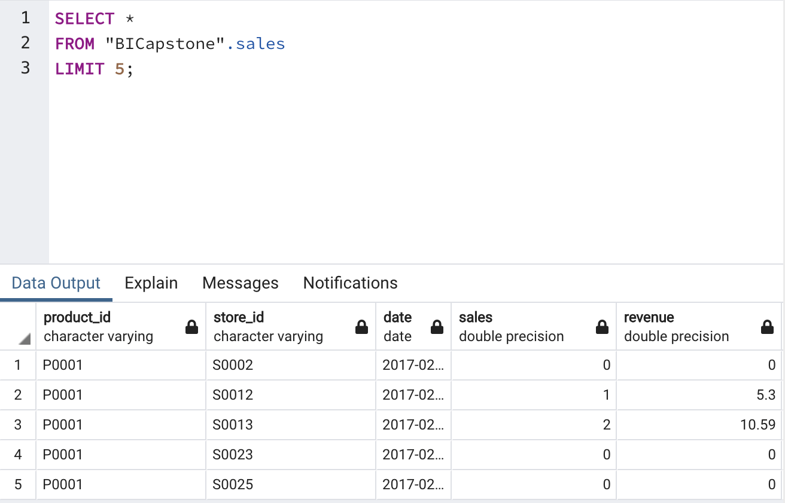
Module 2, Lesson 1: Data Querying Using PostgreSQL
Query that shows Sales performance

Slide 31
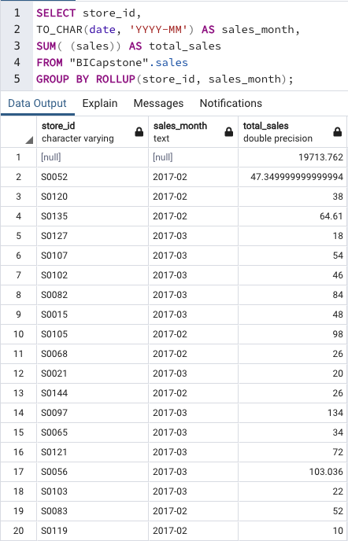
Module 2, Lesson 2: Data Analysis Using PostgreSQL
Create Data Cubes with ROLLUP

Slide 32
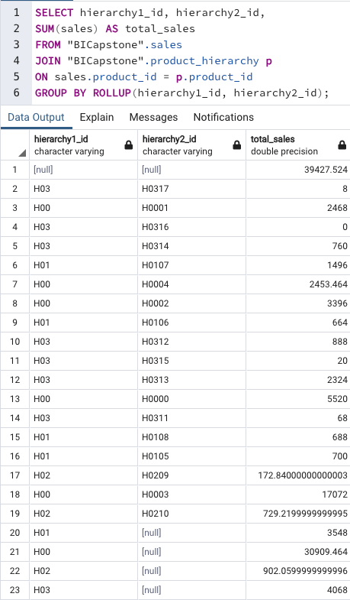
Module 2, Lesson 2: Data Analysis Using PostgreSQL
Summarize Data Along Hierarchies

Slide 33
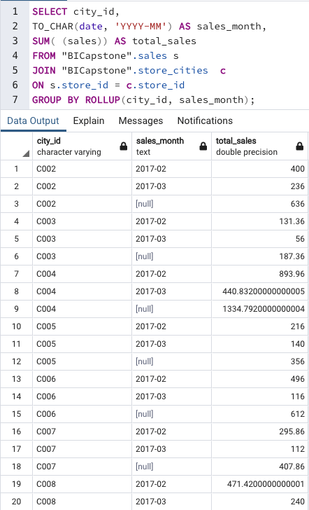
Module 2, Lesson 2: Data Analysis Using PostgreSQL
Identify Sales Trends Over Time and Across Various Regions

Slide 34
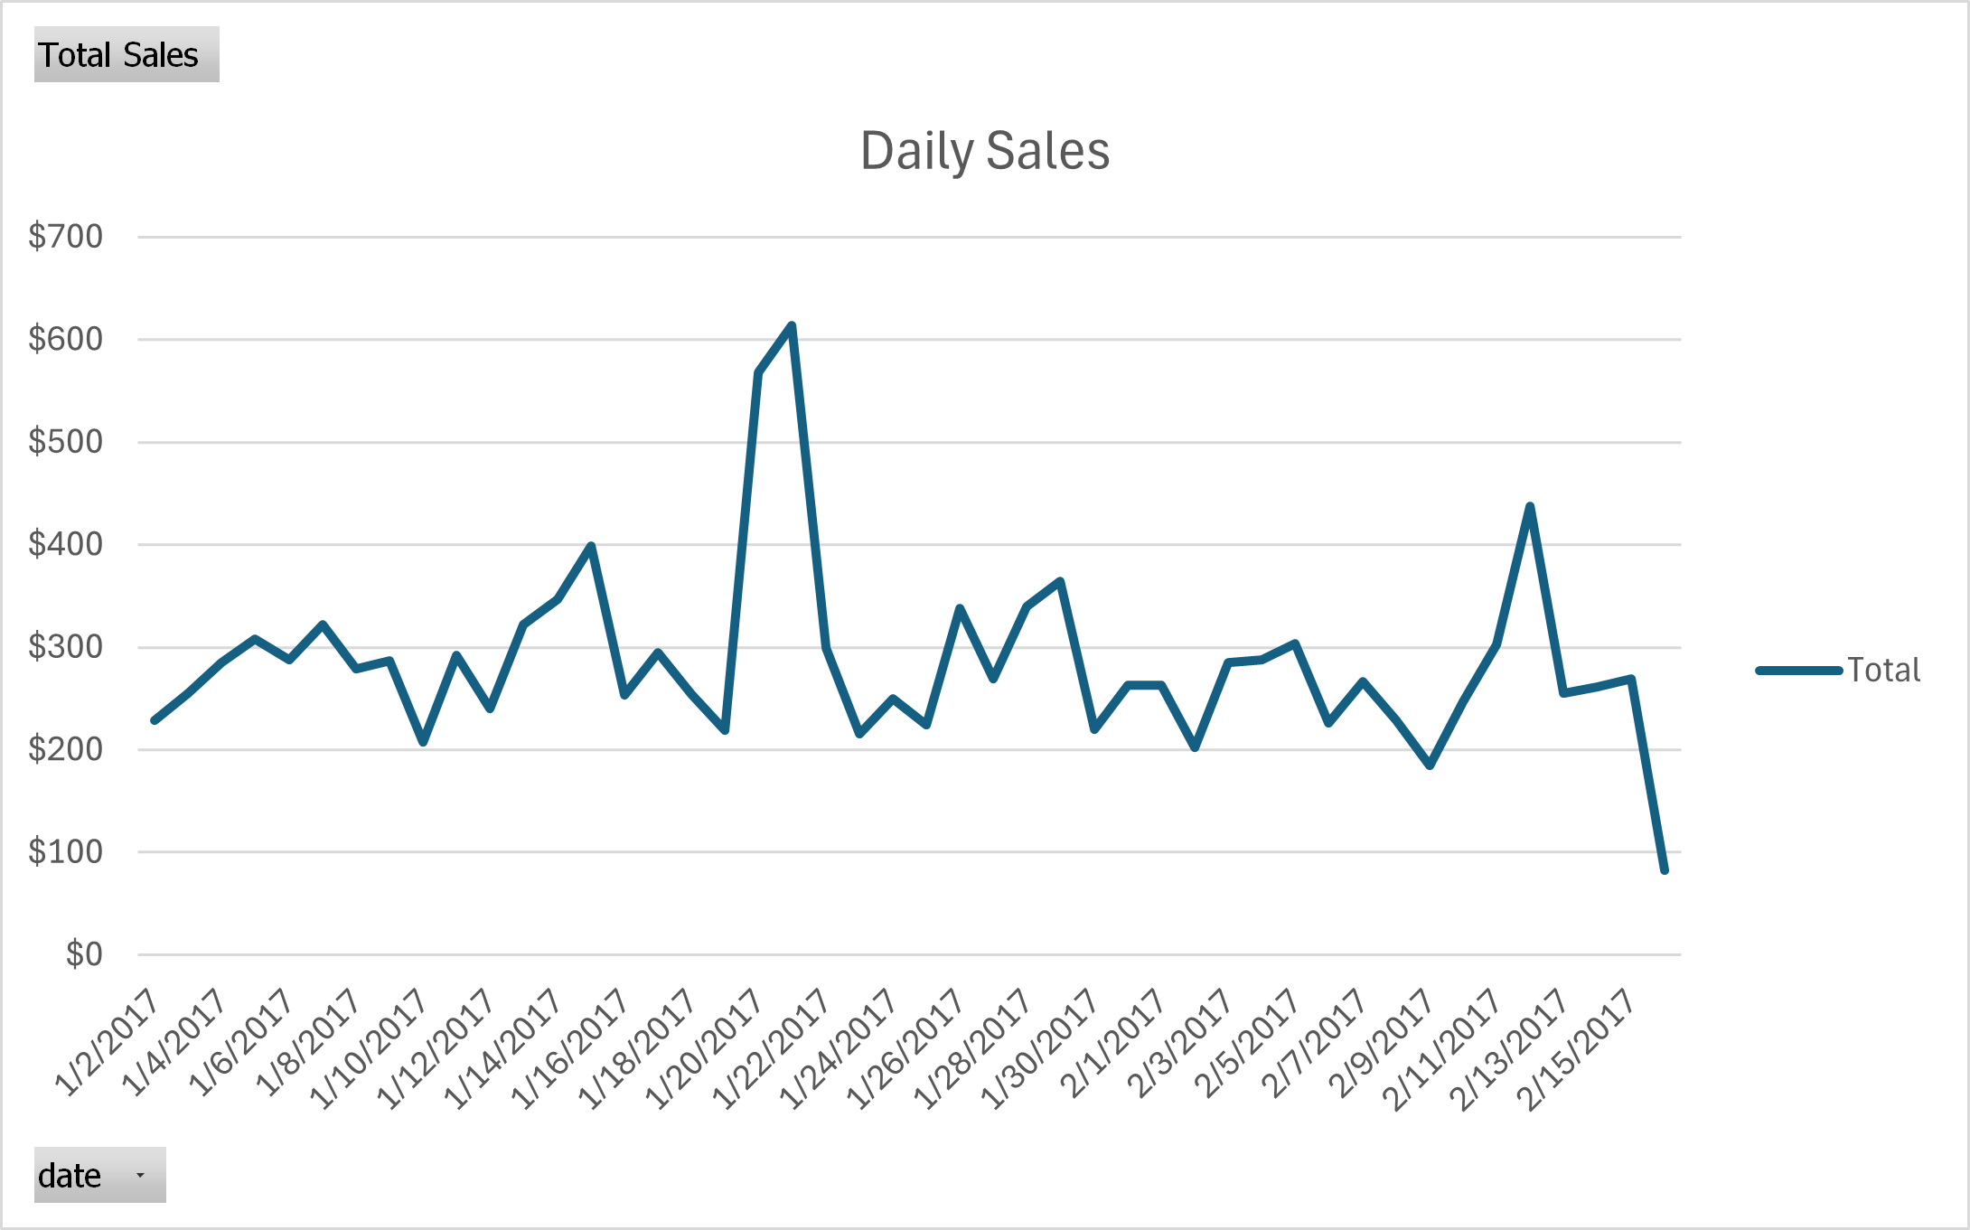
Module 3, Lesson 1: Data Visualization Using Excel
Line Chart

Slide 35
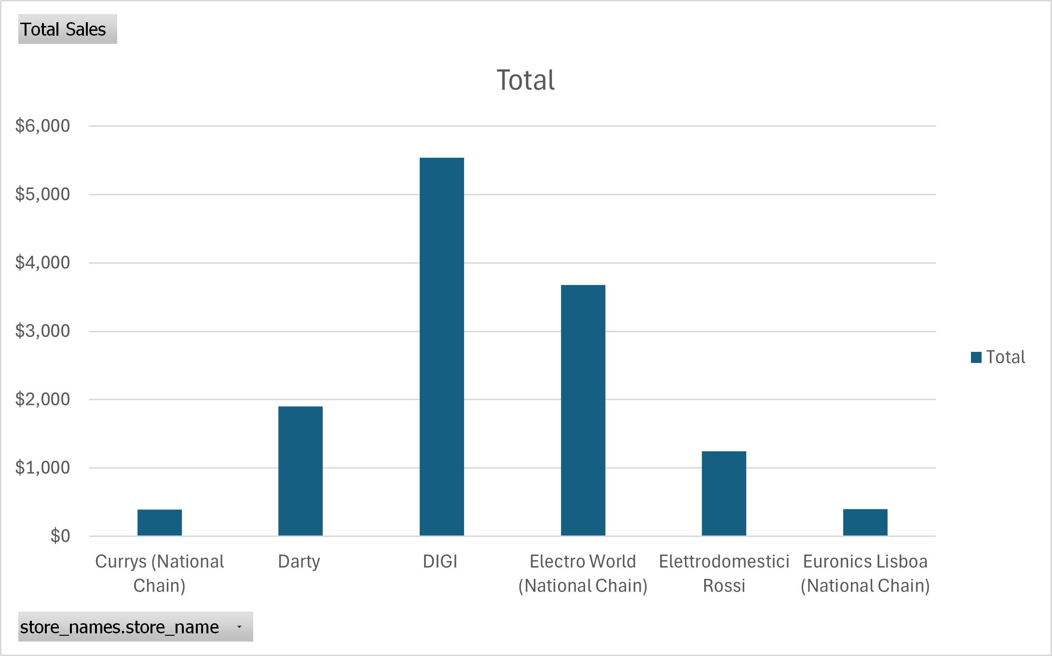
Module 3, Lesson 1: Data Visualization Using Excel
Bar Chart

Slide 36
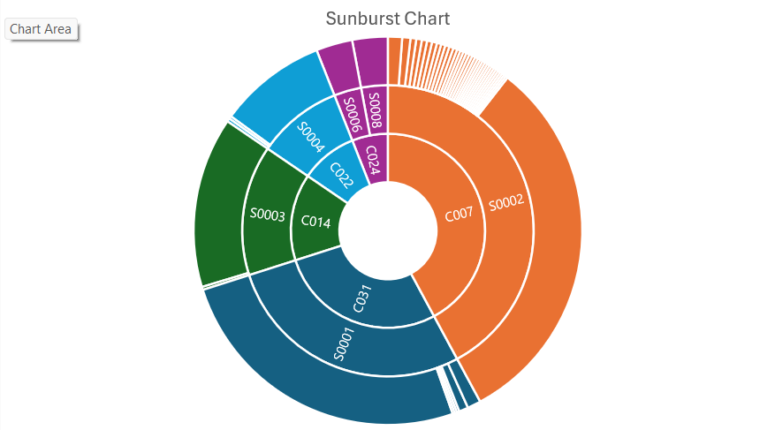
Module 3, Lesson 1: Data Visualization Using Excel
Sunburst Chart

Slide 37
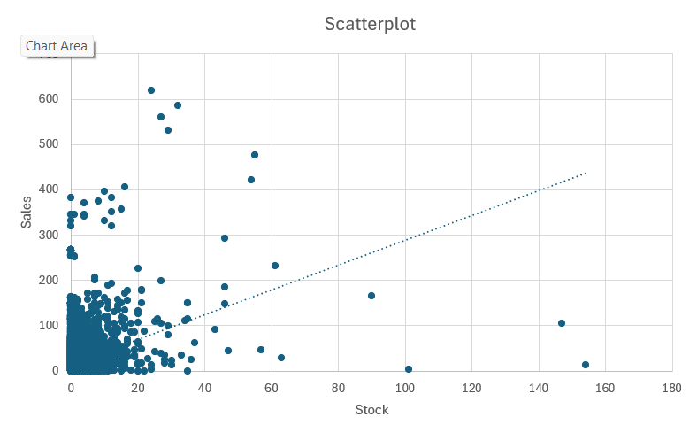
Module 3, Lesson 1: Data Visualization Using Excel
Scatter Plot

Slide 38
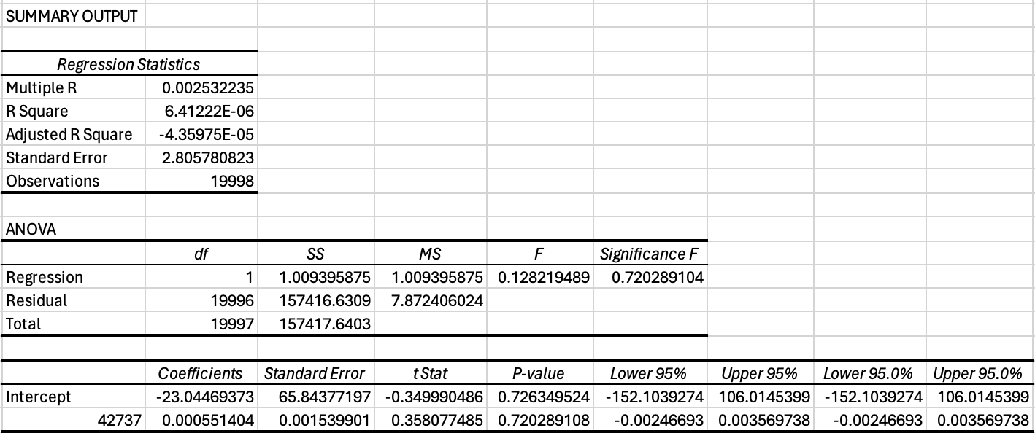
Module 3, Lesson 2: Statistical Analysis
Regression Analysis

Slide 39
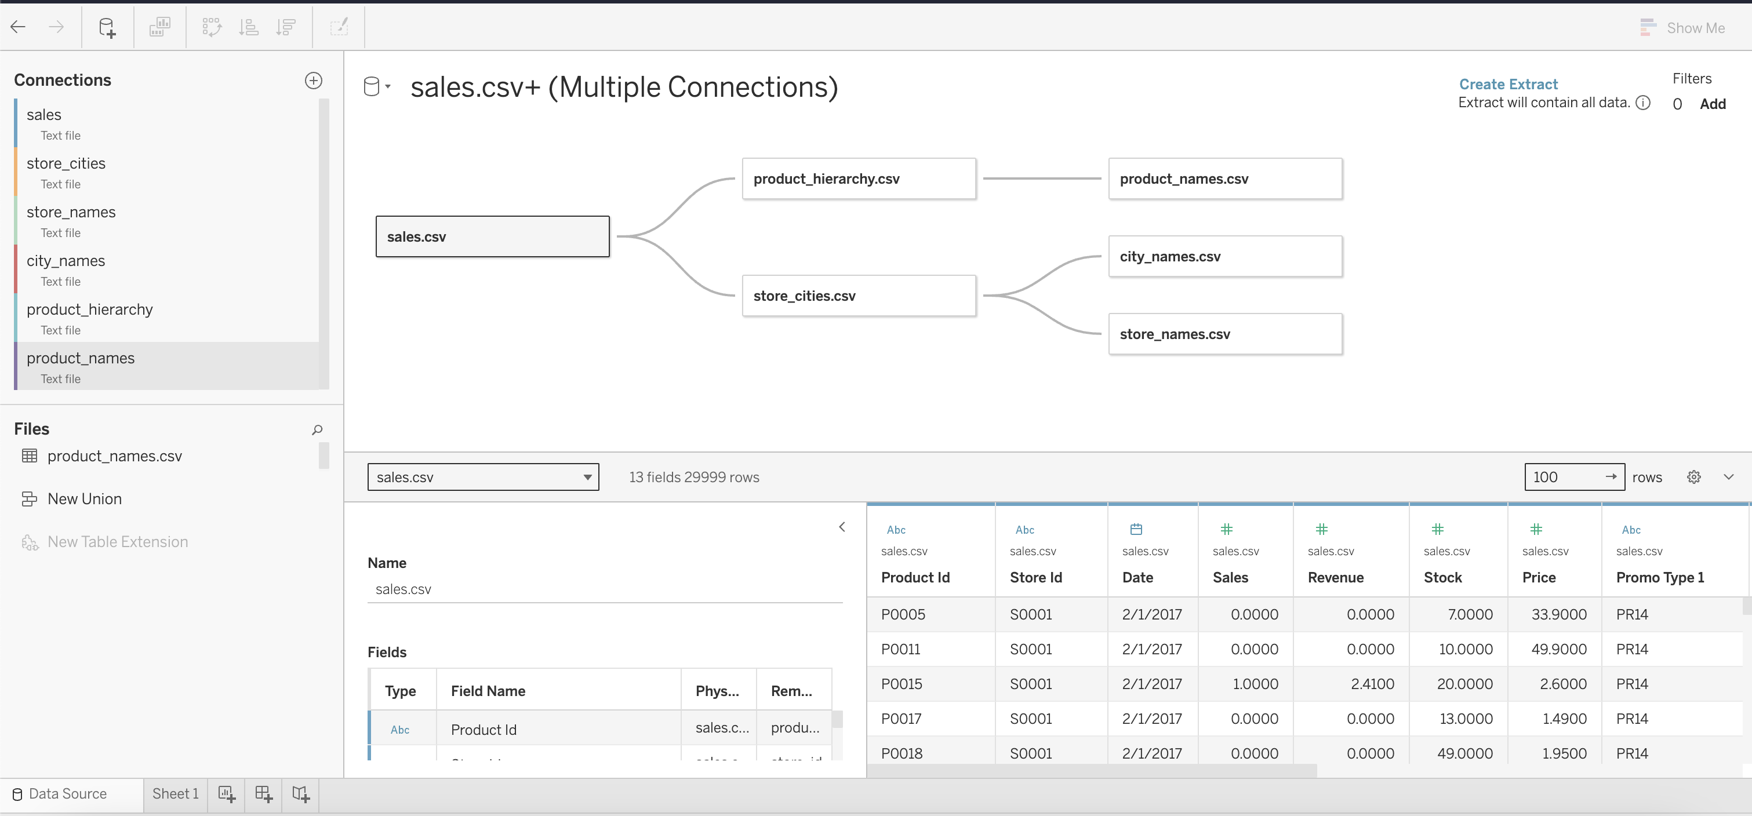
Module 4, Lesson 1: Basic Tableau Visualizations
Entity Relationships

Slide 40
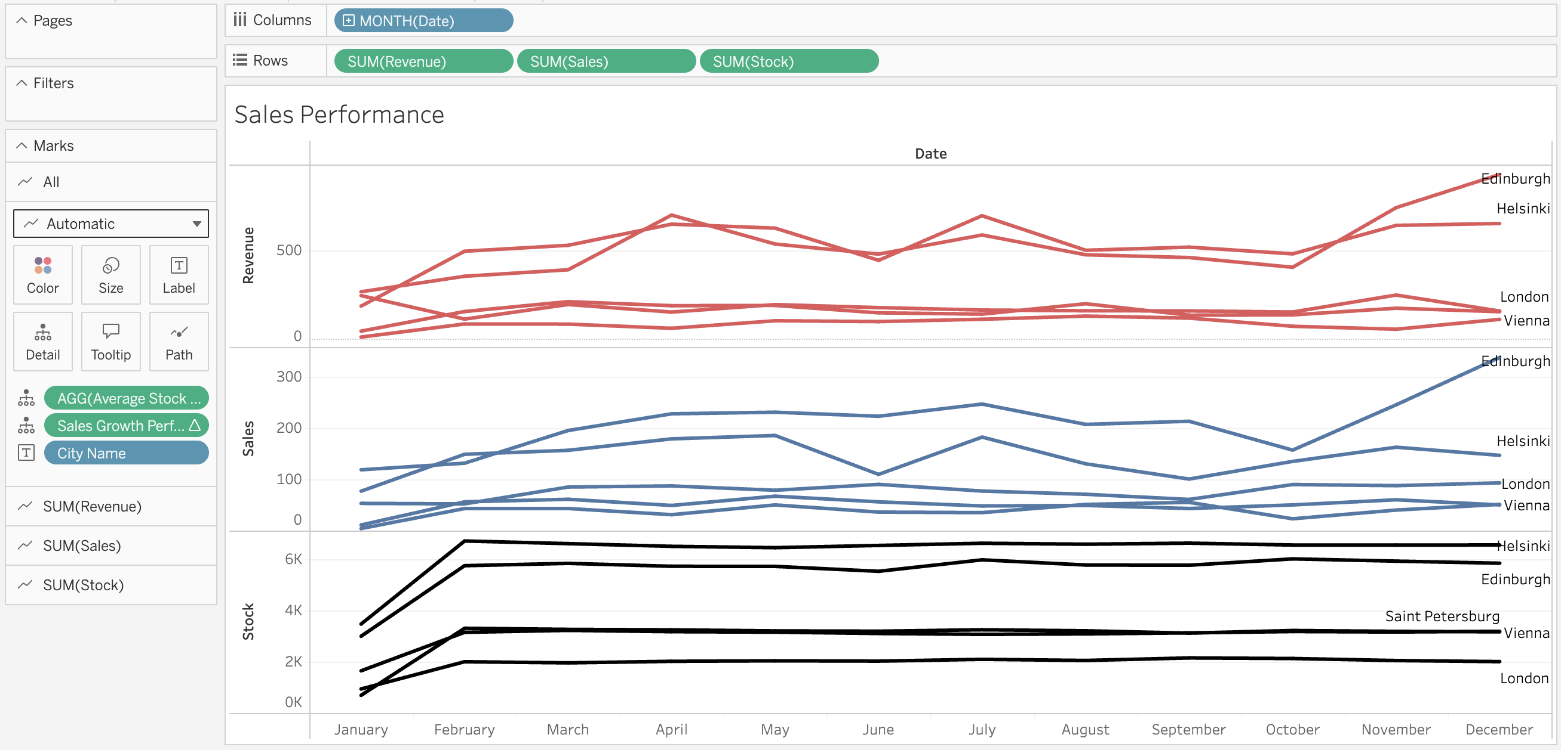
Module 4, Lesson 1: Basic Tableau Visualizations
Line Chart

Slide 41
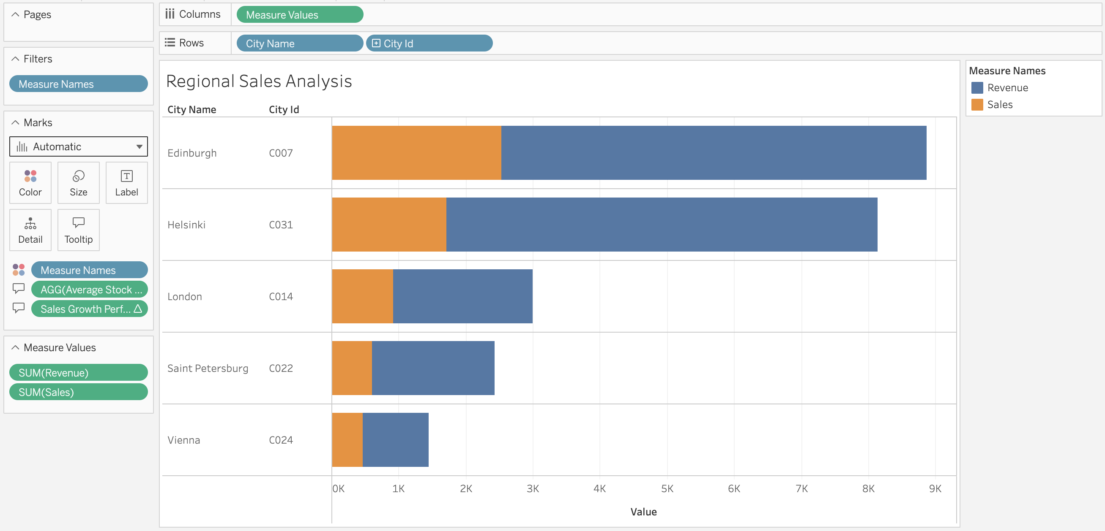
Module 4, Lesson 1: Basic Tableau Visualizations
Bar Chart

Slide 42
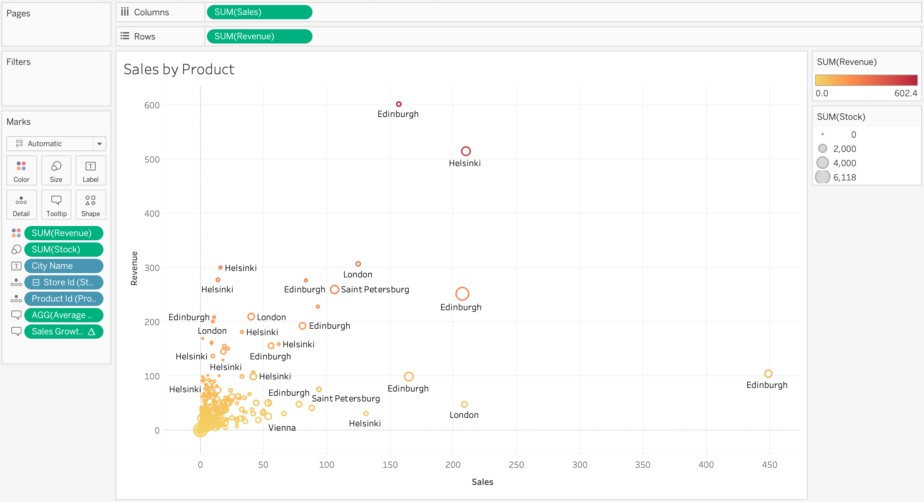
Module 4, Lesson 1: Basic Tableau Visualizations
Scatter Plot

Slide 43
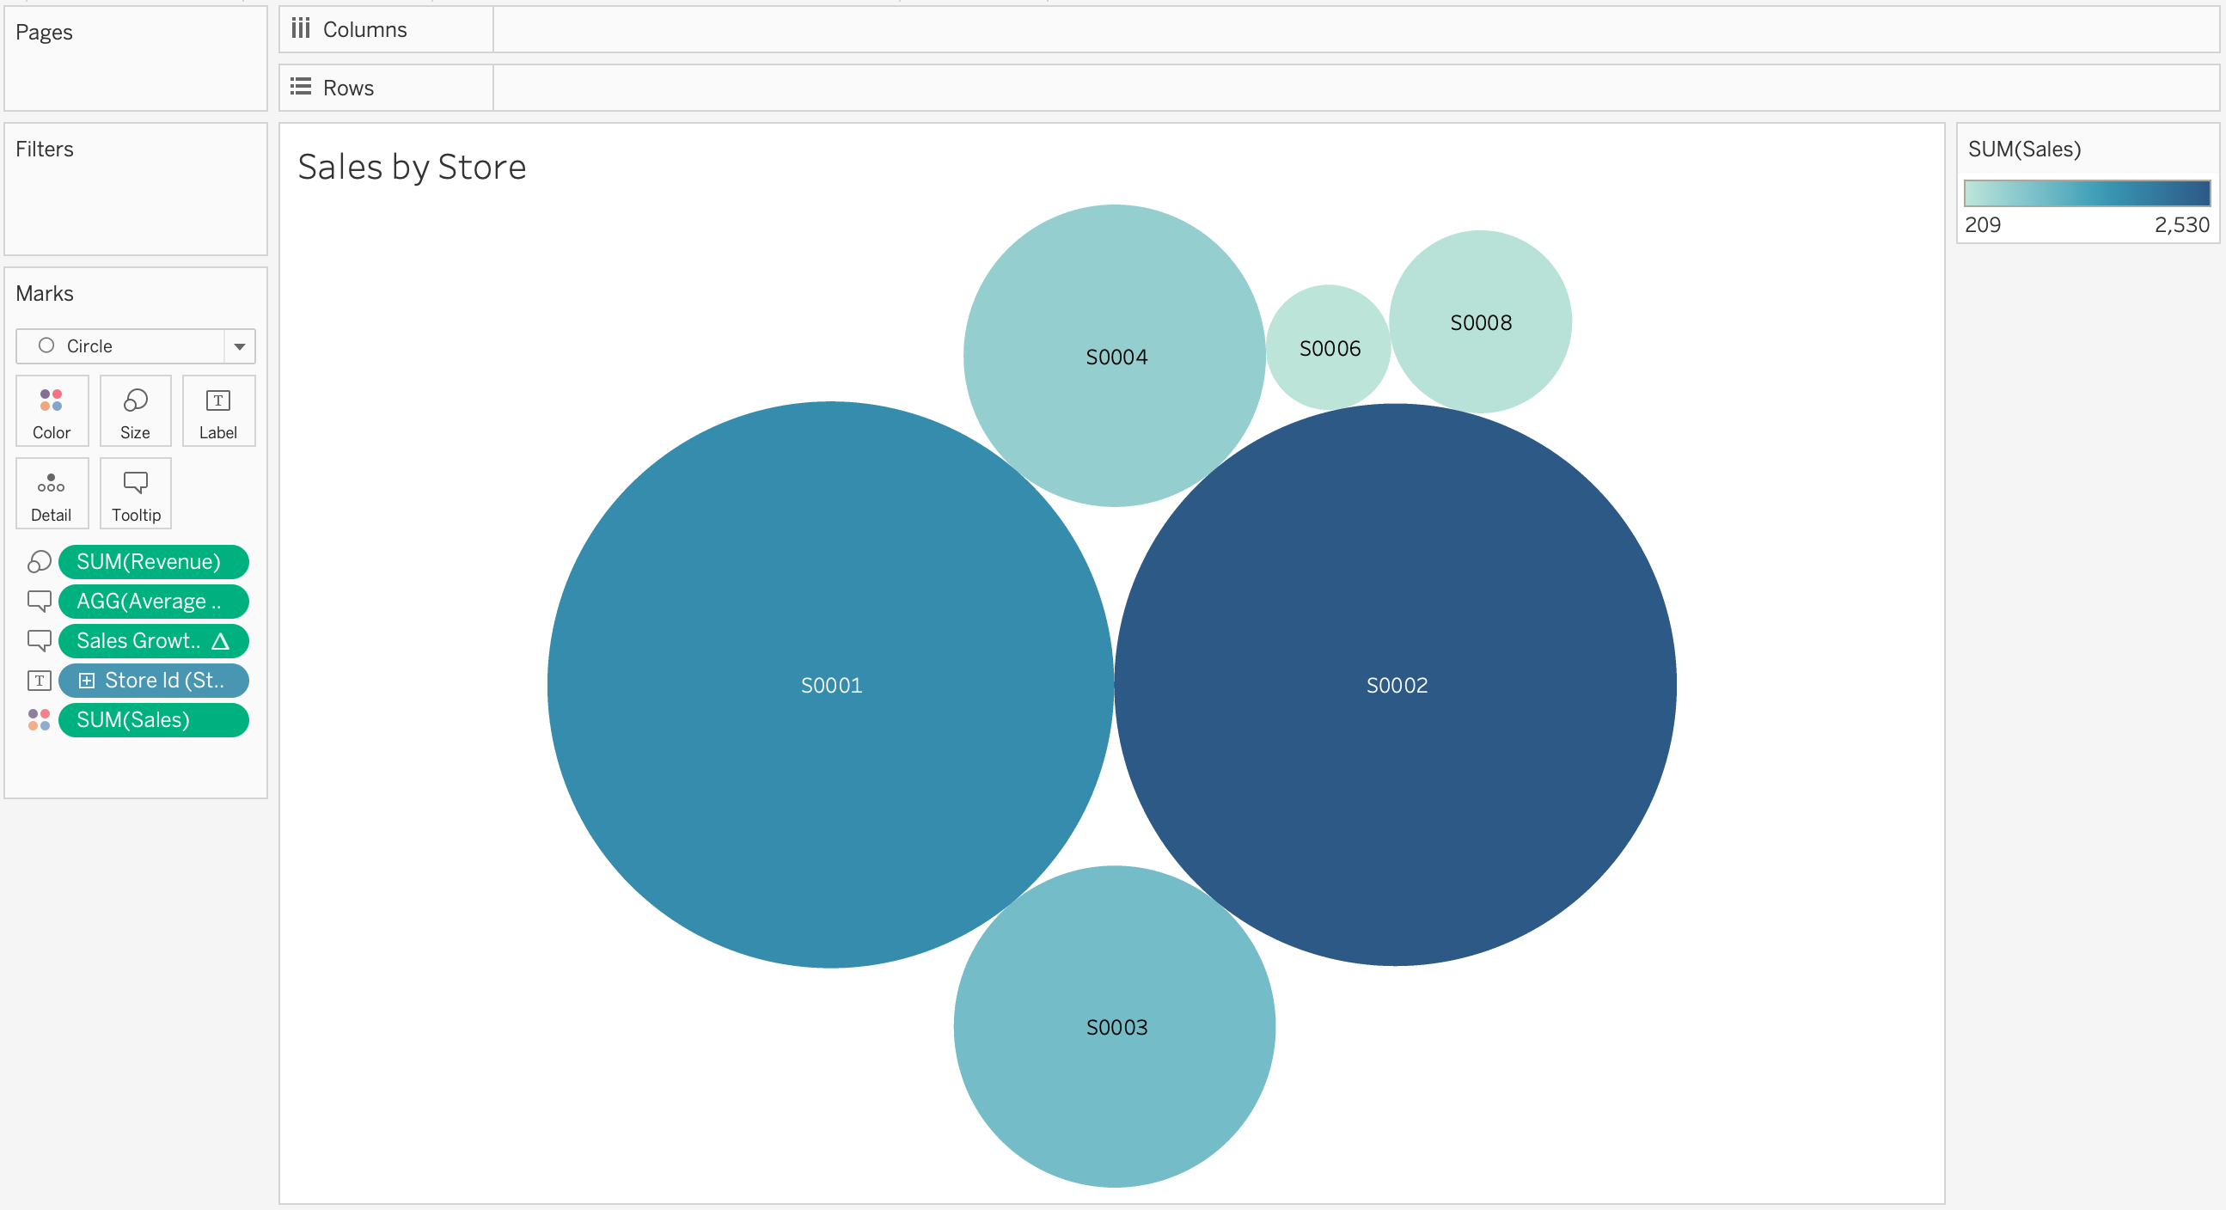
Module 4, Lesson 1: Basic Tableau Visualizations
Packed Bubbles Chart

Slide 44
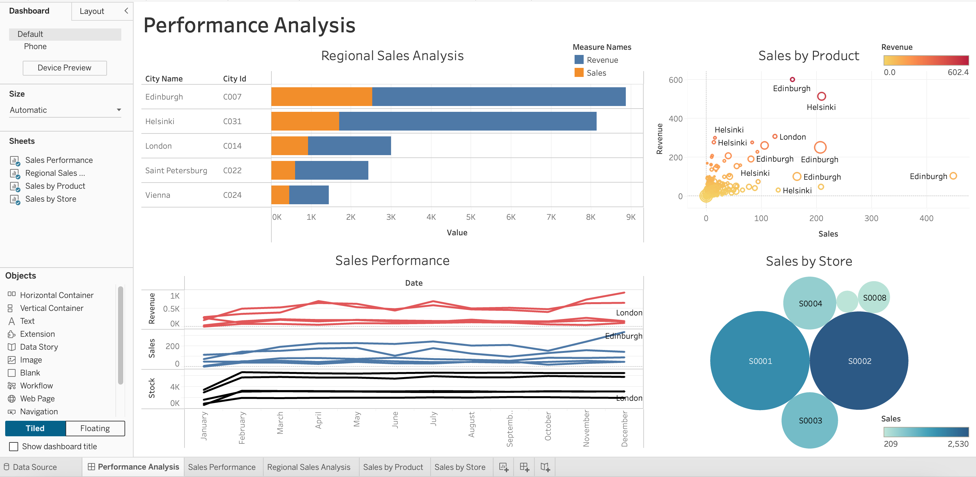
Module 4, Lesson 2: Advanced Visualizations Using Tableau
Dashboard

Slide 45
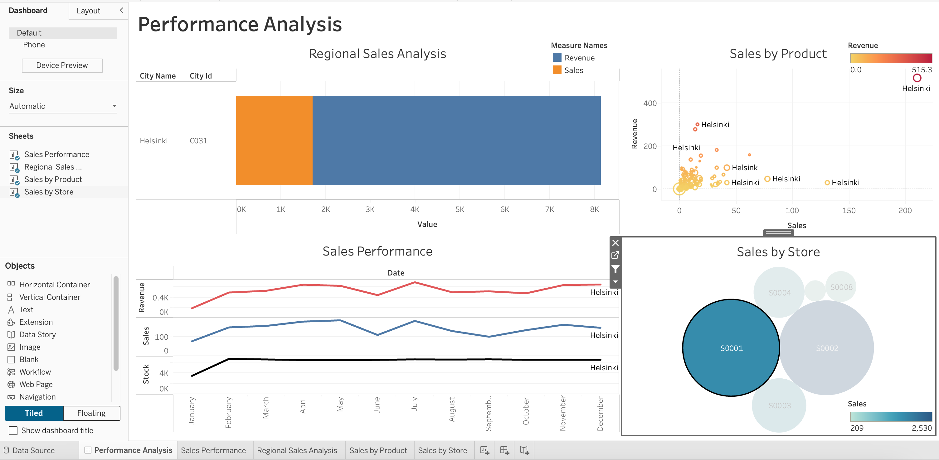
Module 4, Lesson 2: Advanced Visualizations Using Tableau
Filtered Dashboard

Slide 46

Discussion

Slide 47
Insights
20% of products generate 85% of Total Sales
Sales reached their peak in January 2017 across all stores
Edinburgh and Helsinki stores show superior sales performance across a broad range of products
Vienna stores have consistently low sales performance which accounts for only 3.6% of Total Revenue
Stock levels are too high during off-season and show minimal impact on sales performance
Many products don’t generate revenue and should be reviewed to minimize stock
Product P0129 has generated the highest revenue across stores in multiple cities
Products P0282 and Po438 have recorded the highest sales volumes

Slide 48
Recommendations
Implement sales promotions for top-performing products and clearance sales for any long-standing items still in stock
Review product range across all stores to minimize holding costs and ensuring increased availability of top-performing products while minimizing or eliminating stock levels for underperforming products
Remove underperforming products at each store location
Cut operational expenses at store locations with low revenue

Slide 49

Conclusion

Slide 50
Summary
The following areas will require regular attention to achieve a more balanced and efficient operation, stabilize revenue, and reduce any unnecessary costs throughout the year:
Implement clearance sales for long-standing items and other sales promotions
Review product range at each store location
Remove underperforming products from stores
Review and streamline stock levels to minimize holding costs
Cut operational expenses in stores with low revenue
Accounting for seasonal variations in demand and supply

Slide 51

Appendix

Slide 52
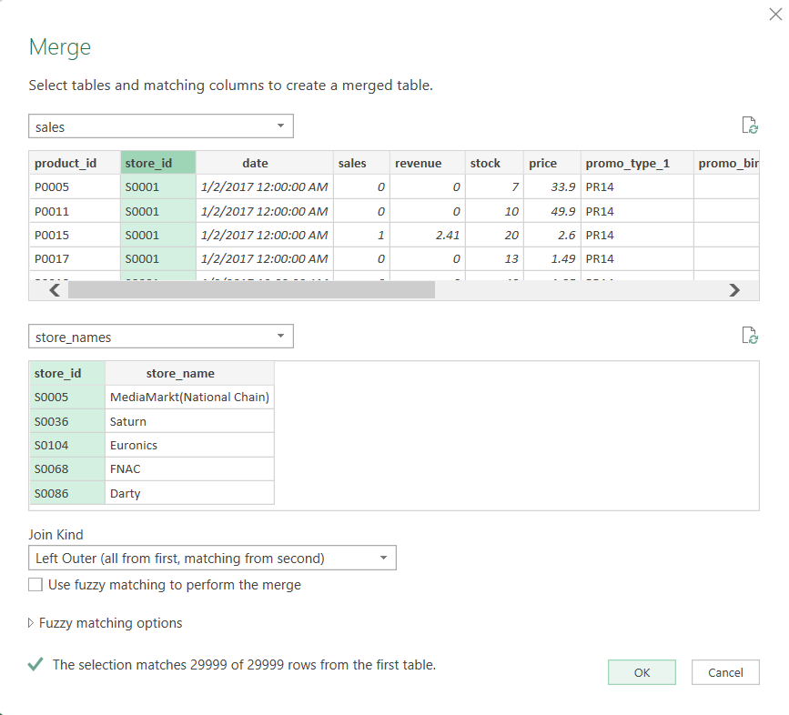
Appendix #
Merge 1

Slide 53
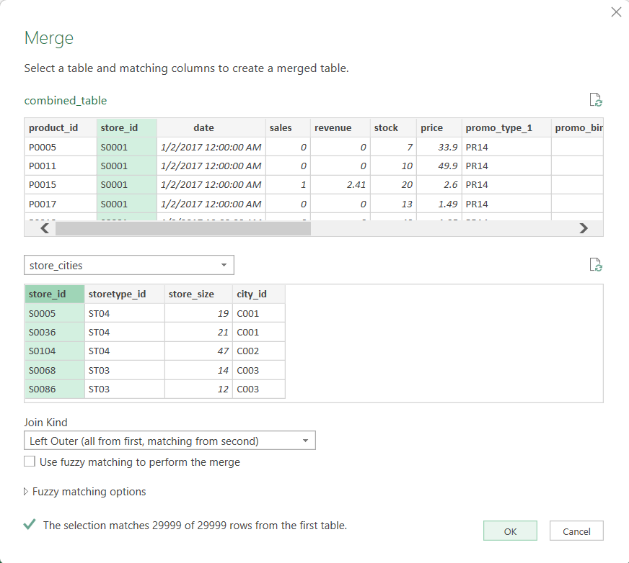
Appendix #
Merge 2

Slide 54
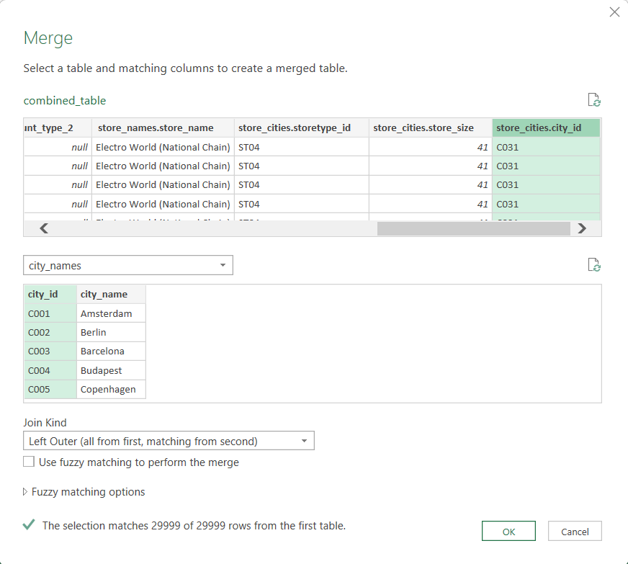
Appendix #
Merge 3

Slide 55
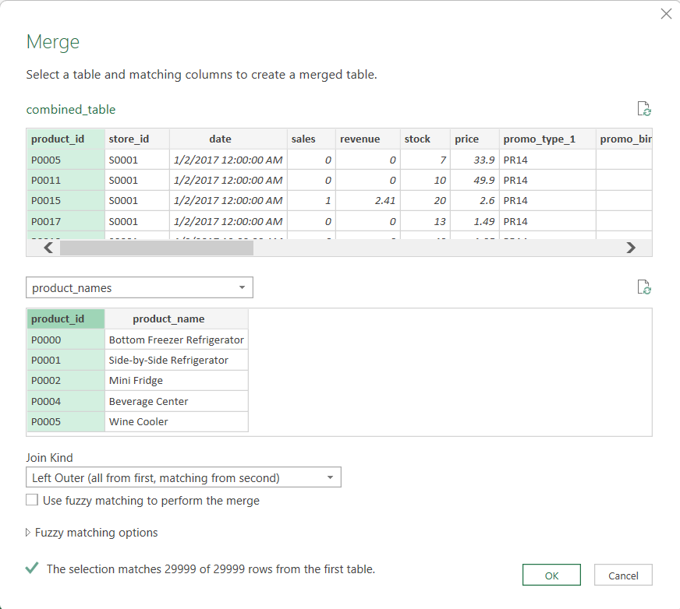
Appendix #
Merge 4

Slide 56
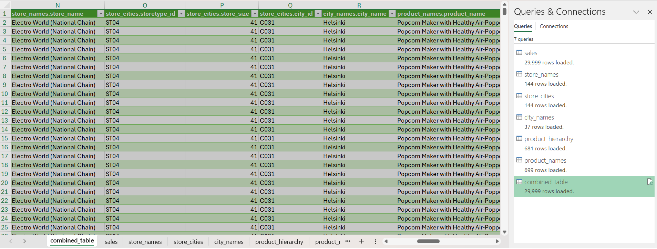
Appendix #
Combined Table

